Slide 1
Introduction to Intel x86-64 Assembly, Architecture, Applications, & Alliteration
Xeno Kovah – 2014
xkovah at gmail

Slide 2
All materials is licensed under a Creative Commons “Share Alike” license.
http://creativecommons.org/licenses/by-sa/3.0/
Attribution condition: You must indicate that derivative work
"Is derived from Xeno Kovah's 'Intro x86-64’ class, available at http://OpenSecurityTraining.info/IntroX86-64.html”
Notes:
Attribution condition: You must indicate that derivative work
"Is derived from Xeno Kovah's ‘Intro x86-64’ class, available at http://OpenSecurityTraining.info/IntroX86-64.html"

Slide 3
Messing with a disassembler
Obfuscation of Executable Code to Improve Resistance to Static Disassembly - Linn & Debray
http://www.cs.arizona.edu/solar/papers/CCS2003.pdf
Linear sweep vs. recursive traversal disassembly
Also discusses and measures the “self-repairing” nature of x86 disassembly which we saw earlier
Confusing linear sweep (objdump) by inserting junk bytes after unconditional jumps.
Could be literally unconditional “jmp”
Could be a jcc, which must always be true, like “xor eax, eax” and then “jz <addr>”
Have to do this multiple times because of the self-repairing disassembly

Slide 4
Messing with disassembler 2
Confusing recursive traversal
3.4.1: Branch functions. All jmps turned into a call to a specific function.
3.4.2: Call conversion. Branch functions + the junk byte technique which messed with linear sweep.
3.4.3: Opaque predicates. Create ostensibly conditional jumps which will in fact always follow only one path. The disassembler doesn’t have the smarts to determine this.
3.4.5: Jump table spoofing. Exploits the fact that the disassembler may try to estimate the size of the jump table based on a constraint. The trick is to add a jump table which will never be reached.

Slide 5
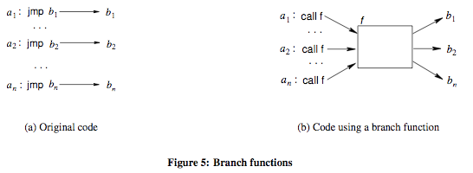
Branch Functions Visualized

Slide 6
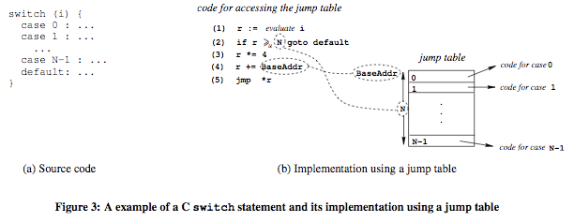
Jump table visualized

Slide 7
Actual implementation of many of these techniques
Nick Harbour actually apparently independently came to the same conclusion as Linn & Debray a few years later, and made a tool that performed some of these obfuscations, and did a defcon talk about it
https://www.defcon.org/images/defcon-16/dc16-presentations/defcon-16-harbour.pdf
http://www.youtube.com/watch?v=wdFLK_eX0QY
https://web.archive.org/web/20100324144525/http://www.rnicrosoft.net/tools/PEScrambler_v0_1.zip

Slide 8
Addressing Linn & Debray obfuscations
Static Disassembly of Obfuscated Binaries - Kruegel et al.
http://www.cs.ucsb.edu/~chris/research/doc/usenix04_disasm.pdf
Attempt to improve on the state of the art in disassembling, to deal with the Linn & Debray obfuscations
I don’t know if there are any disassemblers which try to use these improved disassembly methods (objdump and IDA definitely don’t). Confirmed with Kruegel that he’s not aware of anywhere that uses the improvements either.

