Slide 1
Introduction to Intel x86-64 Assembly, Architecture, Applications, & Alliteration
Xeno Kovah – 2014
xkovah at gmail

Slide 2
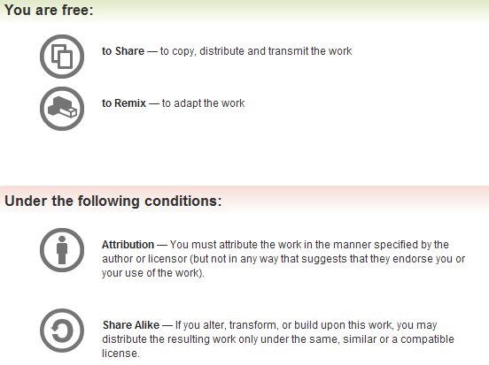
All materials is licensed under a Creative Commons “Share Alike” license.
http://creativecommons.org/licenses/by-sa/3.0/
Attribution condition: You must indicate that derivative work
"Is derived from Xeno Kovah's 'Intro x86-64’ class, available at http://OpenSecurityTraining.info/IntroX86-64.html”
Notes:
Attribution condition: You must indicate that derivative work
"Is derived from Xeno Kovah's ‘Intro x86-64’ class, available at http://OpenSecurityTraining.info/IntroX86-64.html"

Slide 3
gcc - GNU project C and C++ compiler
Available for many *nix systems (Linux/BSD/OSX/Solaris)
Supports many other architectures besides x86
Some C/C++ options, some architecture-specific options
  Main option we care about is building debug symbols. Use “-ggdb” command line argument.
Basically all of the VisualStudio options in the project properties page are just fancy wrappers around giving their compiler command line arguments. The equivalent on *nix is for to developers create “makefile”s which are a configuration or configurations which describes which options will be used for compilation, how files will be linked together, etc. We won’t get that complicated in this class, so we can just specify command line arguments manually.
Book p. 53
Notes:
More details in the manpage, available by typing “man gcc” on a *nix system

Slide 4
gcc basic usage
gcc -o <output filename> <input file name>
  gcc -o hello hello.c
  If -o and output filename are unspecified, default output filename is “a.out” (for legacy reasons)
So we will be using:
  gcc -ggdb -o <filename> <filename>.c
  gcc -ggdb -o Example1 Example1.c

Slide 5
objdump - display information from object files
Where ”object file” can be an intermediate file created during compilation but before linking, or a fully linked executable
  For our purposes means any ELF file - the executable format standard for Linux
The main thing we care about is -d to disassemble a file.
Can override the output syntax with “-M intel”
  Good for getting an alternative perspective on what an instruction is doing, while learning AT&T syntax
Book p. 63
Notes:
More details in the manpage, available by typing “man objdump” on a *nix system
Aside: the equivalent on Mac OS X is otool.

Slide 6
objdump -d hello
hello: file format elf64-x86-64
Disassembly of section .init:
00000000004003e0 <_init>:
4003e0: 48 83 ec 08 sub $0x8,%rsp
4003e4: 48 8b 05 0d 0c 20 00 mov 0x200c0d(%rip),%rax # 600ff8 <_DYNAMIC+0x1d0>
4003eb: 48 85 c0 test %rax,%rax
4003ee: 74 05 je 4003f5 <_init+0x15>
4003f0: e8 3b 00 00 00 callq 400430 <__gmon_start__@plt>
4003f5: 48 83 c4 08 add $0x8,%rsp
4003f9: c3 retq
…
000000000040052d <main>:
40052d: 55 push %rbp
40052e: 48 89 e5 mov %rsp,%rbp
400531: bf d4 05 40 00 mov $0x4005d4,%edi
400536: e8 d5 fe ff ff callq 400410 <puts@plt>
40053b: b8 34 12 00 00 mov $0x1234,%eax
400540: 5d pop %rbp
400541: c3 retq
400542:66 2e 0f 1f 84 00 00 nopw %cs:0x0(%rax,%rax,1)
400549:00 00 00
40054c:0f 1f 40 00 nopl 0x0(%rax)
…

Slide 7
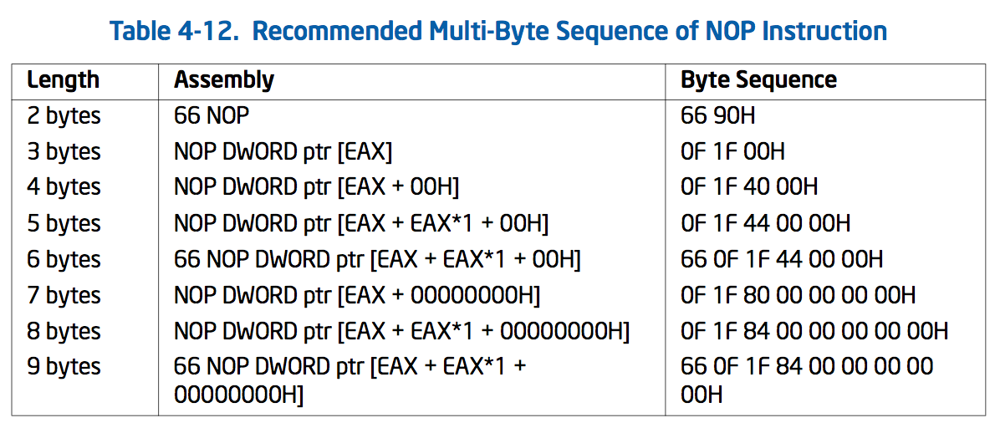
Wait…whut? “nopl/nopw”?
“There are more [NOPS] under heaven and earth, Horatio, than are dreamt of in your philosophy” :)
GCC is clearly using some multi-byte NOPs to pad the end of main() so that the next function starts on a 0x10-aligned boundary

Slide 8
objdump -d -M intel hello
hello: file format elf64-x86-64
Disassembly of section .init:
00000000004003e0 <_init>:
4003e0: 48 83 ec 08 sub rsp,0x8
4003e4: 48 8b 05 0d 0c 20 00 mov rax,QWORD PTR [rip+0x200c0d] # 600ff8 <_DYNAMIC+0x1d0>
4003eb: 48 85 c0 test rax,rax
4003ee: 74 05 je 4003f5 <_init+0x15>
4003f0: e8 3b 00 00 00 call 400430 <__gmon_start__@plt>
4003f5: 48 83 c4 08 add rsp,0x8
4003f9: c3 ret
…
000000000040052d <main>:
40052d: 55 push rbp
40052e: 48 89 e5 mov rbp,rsp
400531: bf d4 05 40 00 mov edi,0x4005d4
400536: e8 d5 fe ff ff call 400410 <puts@plt>
40053b: b8 34 12 00 00 mov eax,0x1234
400540: 5d pop rbp
400541: c3 ret
400542: 66 2e 0f 1f 84 00 00 nop WORD PTR cs:[rax+rax*1+0x0]
400549: 00 00 00
40054c: 0f 1f 40 00 nop DWORD PTR [rax+0x0]
…

Slide 9
hexdump & xxd & strings
Sometimes useful to look at a hexdump to see opcodes/operands or raw file format info
hexdump, hd - ASCII, decimal, hexadecimal, octal dump
  hexdump -C for “canonical” hex & ASCII view
  Use for a quick peek at the hex
xxd - make a hexdump or do the reverse
  Use as a quick and dirty hex editor
  xxd hello > hello.dump
  Edit hello.dump
  xxd -r hello.dump > hello
strings - dump out all the ASCII strings for a binary
Notes:
More details in the manpage, available by typing “man hexdump” and “man xxd” on a *nix system

Slide 10
GDB - the GNU debugger
A command line debugger - quite a bit less user-friendly for beginners.
  There are wrappers such as ddd but I tried them back when I was learning asm and didn’t find them to be helpful. YMMV
Syntax for starting a program in GDB in this class:
  gdb <program name> -x <command file>
  gdb Example1 -x myCmds
Book p. 57

Slide 11
About GDB -x <command file>
Somewhat more memorable long form is “--command=<command file>”
<command file> is a plaintext file with a list of commands that GDB should execute upon starting up. Sort of like scripting the debugger.
Absolutely essential to making GDB reasonable to work with for extended periods of time (I used GDB for many years copying and pasting my command list every time I started GDB, so I was super ultra happy when I found this option)

Slide 12
GDB commands
“help” - internal navigation of available commands
“run” or “r” - run the program
“r <argv>” - run the program passing the arguments in <argv>
  I.e. for Example 2 “r 1 2” would be what we used in windows

Slide 13
GDB commands 2
“help display”
“display” prints out a statement every time the debugger stops
display/FMT EXP
FMT can be a combination of the following:
  i - display as asm instruction
  x or d - display as hex or decimal
  b or h or w or g - display as byte, halfword (2 bytes), word (4 bytes - as opposed to intel calling that a double word. Confusing!), giant word (8 bytes)
  s - character string (will just keep reading till it hits a null character)
  <number> - display <number> worth of things (instructions, bytes, words, strings, etc)
“info display” to see all outstanding display statements and their numbers
“undisplay <num>” to remove a display statement by number
Notes:
Full list of format specifiers
http://sources.redhat.com/gdb/current/onlinedocs/gdb.html#SEC71

Slide 14
GDB commands 3
“x/FMT EXP” - x for “Examine memory” at expression
  Always assumes the given value is a memory address, and it dereferences it to look at the value at that memory address
“print/FMT EXP” - print the value of an expression
  Doesn’t try to dereference memory
Both commands take the same type of format specifier as display
Example:
  (gdb) x/x $rbp
  0x7fffffffde70: 0x00000000
  (gdb) print/x $rbp
  $1 = 0x7fffffffde70
  (gdb) x/x $rbx
  0x0: Cannot access memory at address 0x0
  (gdb) print/x $rbx
  $2 = 0x0
Notes:
Full list of format specifiers
http://sources.redhat.com/gdb/current/onlinedocs/gdb.html#SEC71
From “help x”
FMT is a repeat count followed by a format letter and a size letter.
Format letters are o(octal), x(hex), d(decimal), u(unsigned decimal),
t(binary), f(float), a(address), i(instruction), c(char) and s(string).
Size letters are b(byte), h(halfword), w(word), g(giant, 8 bytes).

Slide 15
GDB commands 4
For all breakpoint-related commands see “help breakpoints”
“break” or “b” - set a breakpoint
  With debugging symbols you can do things like “b main”. Without them you can do things like
  “b *<address>” to break at a given memory address.
  Note: gdb’s interpretation of where a function begins may exclude the function prolog like “push ebp”…
“info breakpoints” or “info b” - show currently set breakpoints
"delete <num> - deletes breakpoint number <num>, where <num> came from "info breakpoints"

Slide 16
GDB 7 commands
New for GDB 7, released Sept 2009
  Thanks to Dave Keppler for notifying me of the availability of these new commands (even if they don’t work in this lab ;))
  reverse-step ('rs') -- Step program backward until it reaches the beginning of a previous source line
  reverse-stepi -- Step backward exactly one instruction
  reverse-continue ('rc') -- Continue program being debugged but run it in reverse
  reverse-finish -- Execute backward until just before the selected stack frame is called

Slide 17
GDB 7 commands 2
  reverse-next ('rn') -- Step program backward, proceeding through subroutine calls.
  reverse-nexti ('rni') -- Step backward one instruction, but proceed through called subroutines.
  set exec-direction (forward/reverse) -- Set direction of execution. All subsequent execution commands (continue, step, until etc.) will run the program being debugged in the selected direction.
Notes:
Currently can’t use /r and /m together

Slide 18
GDB 7 commands 3
  The "disassemble" command now supports an optional /m modifier to print mixed source+assembly.
    (gdb) disassemble/m
    Dump of assembler code for function main:
    2 int main(){
    0x000000000040052d <+0>: push %rbp
    0x000000000040052e <+1>: mov %rsp,%rbp
    3 printf("Hello World!\n");
    => 0x0000000000400531 <+4>: mov $0x4005d4,%edi
    0x0000000000400536 <+9>: callq 0x400410 <puts@plt>
    4 return 0x1234;
    0x000000000040053b <+14>: mov $0x1234,%eax
    5 } 0x0000000000400540 <+19>: pop %rbp
    0x0000000000400541 <+20>: retq
  "disassemble" command with a /r modifier, print the raw instructions in hex as well as in symbolic form.
    (gdb) disassemble/r
    Dump of assembler code for function main:
    0x000000000040052d <+0>: 55 push %rbp
    0x000000000040052e <+1>: 48 89 e5 mov %rsp,%rbp
    => 0x0000000000400531 <+4>: bf d4 05 40 00 mov $0x4005d4,%edi
    0x0000000000400536 <+9>: e8 d5 fe ff ff callq 0x400410 <puts@plt>
    0x000000000040053b <+14>: b8 34 12 00 00 mov $0x1234,%eax
    0x0000000000400540 <+19>: 5d pop %rbp
    0x0000000000400541 <+20>: c3 retq
  See “help disassemble” for full syntax
Notes:
Currently can’t use /r and /m together

Slide 19
initial GDB commands file
display/10i $rip
display/x $rax
display/x $rbx
display/x $rcx
display/x $rdx
display/x $rdi
display/x $rsi
display/x $r8
display/x $r9
display/x $rbp
display/16xg $rsp
break main

Slide 20
(gdb) r
Starting program: /mnt/hgfs/vmshare/IntroToAsm_code_for_class/HelloWorld/hello
Breakpoint 1, main () at Hello.c:3
3 printf("Hello World!\n");
11: x/16xg $rsp
0x7fffffffde70: 0x0000000000000000 0x00007ffff7a35ec5
0x7fffffffde80: 0x0000000000000000 0x00007fffffffdf58
0x7fffffffde90: 0x0000000100000000 0x000000000040052d
0x7fffffffdea0: 0x0000000000000000 0x39f79df94699a772
0x7fffffffdeb0: 0x0000000000400440 0x00007fffffffdf50
0x7fffffffdec0: 0x0000000000000000 0x0000000000000000
0x7fffffffded0: 0xc6086206fb99a772 0xc60872bffa63a772
0x7fffffffdee0: 0x0000000000000000 0x0000000000000000
10: /x $rbp = 0x7fffffffde70
9: /x $r9 = 0x7ffff7dea560
8: /x $r8 = 0x7ffff7dd4e80
7: /x $rsi = 0x7fffffffdf58
6: /x $rdi = 0x1
5: /x $rdx = 0x7fffffffdf68
4: /x $rcx = 0x0
3: /x $rbx = 0x0
2: /x $rax = 0x40052d
1: x/10i $rip
=> 0x400531 <main+4>: mov $0x4005d4,%edi
0x400536 <main+9>: callq 0x400410 <puts@plt>
0x40053b <main+14>: mov $0x1234,%eax
0x400540 <main+19>: pop %rbp
0x400541 <main+20>: retq
Example run with commands file
Source code line printed here if source is available (e.g. compiled with -ggbd)

Slide 21
Stepping
“stepi” or “si” - steps one asm instruction at a time
  Will always “step into” subroutines
“nexti” or “ni” - steps over one asm instruction at a time
  Will always “step over” subroutines
“step” or “s” - steps one source line at a time (if no source is available, works like stepi)
“until” or “u” - steps until the next source line, not stepping into subroutines
  If no source available, this will work like a stepi that will “step over” subroutines
“finish” - steps out of the current function

Slide 22
GDB misc commands
“set disassembly-flavor intel” - use intel syntax rather than AT&T
  Again, not using now, just good to know
“continue” or “c” - run until you hit another breakpoint or the program ends
“backtrace” or “bt” - print a trace of the call stack, showing all the functions which were called before the current function

Slide 23
Lab time:
Running all the examples we ran earlier with Windows/VS with Linux/GDB

