Slide 1
Introduction to Intel x86-64 Assembly, Architecture, Applications, & Alliteration
Xeno Kovah – 2014
xkovah at gmail

Slide 2
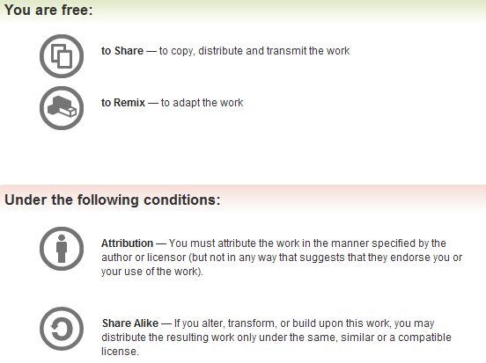
All materials is licensed under a Creative Commons “Share Alike” license.
http://creativecommons.org/licenses/by-sa/3.0/
Attribution condition: You must indicate that derivative work
"Is derived from Xeno Kovah's 'Intro x86-64’ class, available at http://OpenSecurityTraining.info/IntroX86-64.html”
Notes:
Attribution condition: You must indicate that derivative work
"Is derived from Xeno Kovah's ‘Intro x86-64’ class, available at http://OpenSecurityTraining.info/IntroX86-64.html"

Slide 3
Refresher - Boolean (“bitwise”) logic
AND “&”
OR “|”
XOR “^”
0 | 0 | 0
0 | 1 | 0
1 | 0 | 0
1 | 1 | 1
0 | 0 | 0
0 | 1 | 1
1 | 0 | 1
1 | 1 | 1
0 | 0 | 0
0 | 1 | 1
1 | 0 | 1
1 | 1 | 0
Operands
Result
NOT “~”
0 | 1
1 | 0

Slide 4
14
AND - Logical AND
Destination operand can be r/mX or register
Source operand can be r/mX or register or immediate (No source and destination as r/mXs)
and al, bl
and al, 0x42
 | 00110011b (al - 0x33)
AND | 01010101b (bl - 0x55)
result | 00010001b (al - 0x11)
 | 00110011b (al - 0x33)
AND | 01000010b (imm - 0x42)
result | 00000010b (al - 0x02)
Book p. 231

Slide 5
15
OR - Logical Inclusive OR
Destination operand can be r/mX or register
Source operand can be r/mX or register or immediate (No source and destination as r/mXs)
or al, bl
or al, 0x42
 | 00110011b (al - 0x33)
OR | 01010101b (bl - 0x55)
result | 01110111b (al - 0x77)
 | 00110011b (al - 0x33)
OR | 01000010b (imm - 0x42)
result | 01110011b (al - 0x73)
Book p. 231

Slide 6
16
XOR - Logical Exclusive OR
Destination operand can be r/mX or register
Source operand can be r/mX or register or immediate (No source and destination as r/mXs)
xor al, al
xor al, 0x42
 | 00110011b (al - 0x33)
XOR | 00110011b (al - 0x33)
result | 00000000b (al - 0x00)
 | 00110011b (al - 0x33)
OR | 01000010b (imm - 0x42)
result | 01110001b (al - 0x71)
XOR is commonly used to zero a
register, by XORing it with itself,
because it’s faster than a MOV
Book p. 231

Slide 7
17
NOT - One's Complement Negation
Single source/destination operand can be r/mX
not al
not [al+bl]
NOT | 00110011b (al - 0x33)
result | 11001100b (al - 0xCC)
al | 0x10000000
bl | 0x00001234
al+bl | 0x10001234
[al+bl] | 0 (assumed memory at 0x10001234)
NOT | 00000000b
result | 11111111b
Xeno trying to be clever on a boring example, and failing…
Book p. 231

Slide 8

ForLoop.c - simple for loop
main:
0000000140001010 sub rsp,38h
0000000140001014 mov dword ptr [rsp+20h],0
000000014000101C jmp 0000000140001028
000000014000101E mov eax,dword ptr [rsp+20h]
0000000140001022 inc eax
0000000140001024 mov dword ptr [rsp+20h],eax
0000000140001028 cmp dword ptr [rsp+20h],0Ah
000000014000102D jge 0000000140001042
000000014000102F mov edx,dword ptr [rsp+20h]
0000000140001033 lea rcx,[40006000h]
000000014000103A call qword ptr [40008368h]
0000000140001040 jmp 000000014000101E
0000000140001042 xor eax,eax
0000000140001044 add rsp,38h
0000000140001048 ret
#include <stdio.h>
int main(){
int i;
for(i = 0; i < 10; i++){
printf("i = %d\n", i);
}
}

Slide 9
INC/DEC - Increment / decrement
18
19
Single source/destination operand can be r/mX
Increase or decrease the value by 1
When optimized, compilers will tend to favor not using inc/dec, as directed by the Intel optimization guide. So their presence may be indicative of hand-written, or un-optimized code
rax | 0x7e117a1e
rax | 0xdec0ded
xor rax, rax
mov rax, 0
rax | 0x0
rax | 0x0
inc rax
dec rax
rax | 0x1
rax | 0xFFFFFFFF`FFFFFFFF
Book p. 215-216

Slide 10
ForLoop.c - takeaways
For loops will be some combination of a JCC (to determine if the exit condition is met yet), and an absolute JMP (to return from the end to the conditional checking code)
In the absence of an explicit return value VS & GCC default to returning 0
main:
0000000140001010 sub rsp,38h
0000000140001014 mov dword ptr [rsp+20h],0
000000014000101C jmp 0000000140001028
000000014000101E mov eax,dword ptr [rsp+20h]
0000000140001022 inc eax
0000000140001024 mov dword ptr [rsp+20h],eax
0000000140001028 cmp dword ptr [rsp+20h],0Ah
000000014000102D jge 0000000140001042
000000014000102F mov edx,dword ptr [rsp+20h]
0000000140001033 lea rcx,[40006000h]
000000014000103A call qword ptr [40008368h]
0000000140001040 jmp 000000014000101E
0000000140001042 xor eax,eax
0000000140001044 add rsp,38h
0000000140001048 ret
#include <stdio.h>
int main(){
int i;
for(i = 0; i < 10; i++){
printf("i = %d\n", i);
}
}

Slide 11
Instructions we now know (22)
NOP
PUSH/POP
CALL/RET
MOV
ADD/SUB
IMUL
MOVZX/MOVSX
LEA
JMP/Jcc (family)
CMP/TEST
AND/OR/XOR/NOT
INC/DEC

