Slide 1
Introduction to Intel x86-64 Assembly, Architecture, Applications, & Alliteration
Xeno Kovah – 2014
xkovah at gmail

Slide 2
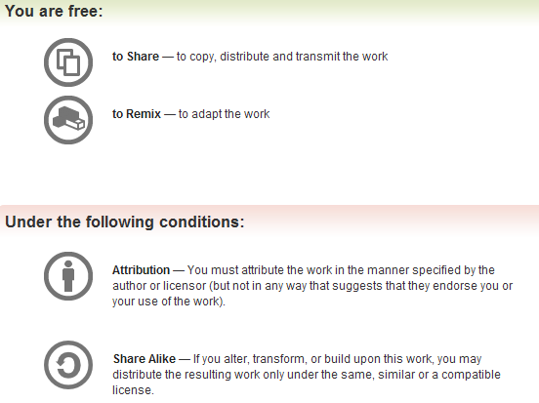
All materials is licensed under a Creative Commons “Share Alike” license.
http://creativecommons.org/licenses/by-sa/3.0/
Attribution condition: You must indicate that derivative work
"Is derived from Xeno Kovah's 'Intro x86-64’ class, available at http://OpenSecurityTraining.info/IntroX86-64.html”
Notes:
Attribution condition: You must indicate that derivative work
"Is derived from Xeno Kovah's ‘Intro x86-64’ class, available at http://OpenSecurityTraining.info/IntroX86-64.html"

Slide 3
The Stack
The stack is a conceptual area of main memory (RAM) which is designated by the OS when a program is started.
Different OS start it at different addresses by convention
A stack is a Last-In-First-Out (LIFO/FILO) data structure where data is "pushed" on to the top of the stack and "popped" off the top.
By convention the stack grows toward lower memory addresses. Adding something to the stack means the top of the stack is now at a lower memory address.

Slide 4
The Stack 2
As already mentioned, RSP points to the top of the stack, the lowest address which is being used
While data will exist at addresses beyond the top of the stack, it is considered undefined
The stack keeps track of which functions were called before the current one, it holds local variables and is frequently used to pass arguments to the next function to be called.
A firm understanding of what is happening on the stack is *essential* to understanding a program’s operation.

Slide 5
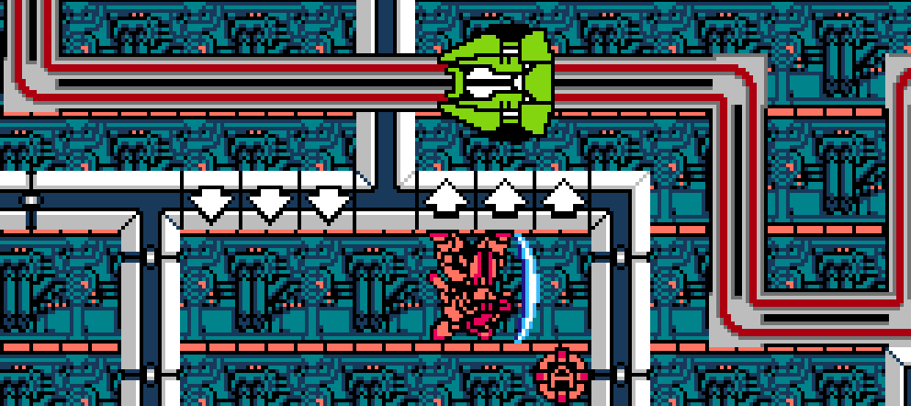
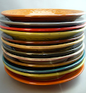
The stack grows down towards low addresses!
RSP
This message brought to you by M-308 Gunner from MetalStorm!
Notes:
http://satoshimatrix.files.wordpress.com/2011/08/metal-storm-u-0009.png
http://2.bp.blogspot.com/_OcRaBrP1awY/SAelZhj61tI/AAAAAAAAATw/NudzjUumtRk/s400/luncheon_plates_stacks_DSCN4744.JPG

Slide 6
2
PUSH - Push Word, Doubleword or Quadword onto the Stack
For our purposes, it will always be a QWORD (8 bytes).
Can either be an “immediate” (Intel’s term for a numeric constant), or the value in a register
The push instruction automatically decrements the stack pointer, RSP, by 8.
Book p. 120
Notes:
Will always be a QWORD because we will be running the processor in 64bit mode, and the instruction for a 16 bit push is the same as the one for a 32bit push is the same as the one for a 64 bit push. The processor just interprets the size based on the mode it is currently running in (or more accurately the segment, but that’s a story for Intermediate x86-64 ;))

Slide 7
Registers Before
Registers After
push RAX
RAX | 0x00000000`00000003
RSP | 0x00000000`0012FF88
RAX | 0x00000000`00000003
RSP | 0x00000000`0012FF80
Stack Before
Stack After
0x00000000`0012FF90 | 0x00000000` 00000001
0x00000000`0012FF88 | 0x00000000` 00000002
0x00000000`0012FF80 | undef
0x00000000`0012FF78 | undef
0x00000000` 00000001
0x00000000` 00000002
0x00000000` 00000003
undef
RSP
RSP

Slide 8
Note about the ` address convention
When writing 64 bit numbers, it can be easy to lose track of whether you have the right number of digits
WinDbg (which we don’t use in this class, but do in the Intermediate x86-64 class) allows you to write 64 bit numbers with a ` between the two 32 bit halves.
I think this is helpful to see when a number is > 32 bit or not (because there will be some non-zero value on the left side of the `)
So in this class I’ll write 64 bit numbers like 0x12345678`12345678.
But keep in mind that the only tool which probably supports you entering them like that is WinDbg

Slide 9
3
POP- Pop a Value from the Stack
Take a QWORD off the stack, put it in a register, and increment RSP by 8
(Also has a “pop-into-memory” form which you can look up when you're more advanced and you know how to RTFM :))
Book p. 120

Slide 10
Registers Before
Registers After
pop RAX
RAX | unknown
RSP | 0x00000000`0012FF80
RAX | 0x00000000`00000003
RSP | 0x00000000`0012FF88
Stack Before
Stack After
0x00000000`0012FF90 | 0x00000000` 00000001
0x00000000`0012FF88 | 0x00000000` 00000002
0x00000000`0012FF80 | 0x00000000` 00000003
0x00000000`0012FF78 | undef
0x00000000` 00000001
0x00000000` 00000002
undef
undef
RSP
RSP

Slide 11
Ahoy-hoy!
Yello?
Calling Conventions
How code calls a subroutine is compiler-dependent and configurable. But there are a few conventions.
More info at
http://en.wikipedia.org/wiki/X86_calling_conventions
http://www.programmersheaven.com/2/Calling-conventions
Calling convention (as well as other assembly generation particulars) can be used as a first order heuristic of what compiler was used to generate the code
Notes:
http://i.ytimg.com/vi/qonpElvRu8Q/hqdefault.jpg
http://4.bp.blogspot.com/_bngNvVpYNjI/TQBABjDToQI/AAAAAAAABJk/Z25l1apkbmY/s320/HomerSimpsonTowel.gif

Slide 12
Einstein!
Calling Conventions Microsoft x86-64
First 4 parameters (from left to right) are put into RCX, RDX, R8, R9 respectively
Remaining parameters > 4 are pushed onto the stack
NO use of frame pointers (if you know 32 bit calling conventions. If not, ignore this bullet)
RAX or RDX:RAX returns the result for primitive data types
Caller is responsible for cleaning up the stack
Notes:
Colon notation means the full value is represented by the concatenation of the two values.
If rdx = 0x11112222 and eax = 0x33334444, then rdx:eax is the quadword 0x1111222233334444
http://2.bp.blogspot.com/-RA88gtJkvMM/UUYB6qSrLiI/AAAAAAAAADw/NU7nOMw8kCE/s1600/Eisntein5.jpg

Slide 13
Yeobeoseyo!
Calling Conventions System V AMD64 ABI (GCC)
First 6 parameters (from left to right) are put into RDI, RSI, RDX, RCX, R8, R9 respectively
Remaining parameters pushed onto the stack
Use of frame pointers (if you know 32 bit calling conventions. If not, ignore this bullet)
RAX or RDX:RAX returns the result for primitive data types
Caller is responsible for cleaning up the stack
Notes:
http://24.media.tumblr.com/tumblr_m9p96hnQVc1qgy3iwo1_500.gif
TODO: calling convention identification reinforcement goes here, or at end of deck, or after we’ve seen some asm?
Give students an example randomized C call, and the equivalent templated, randomized, x86 code and ask them to pick which calling convention it uses

Slide 14
General Stack Frame Operation
We are going to pretend that main() is the very first function
being executed in a program. This is what its stack looks like
to start with (assuming it has any local variables).
stack bottom
Local Variables
main() frame
undef
undef
…
stack top
Book p. 306

Slide 15
General Stack Frame Operation 2
When main() decides to call a subroutine, main() becomes “the caller”. We will assume main() has some registers it would like to remain the same, so it will save them. We will also assume that the callee function takes some input arguments.
stack bottom
Local Variables
Caller-Save Registers
Arguments to Pass to Callee
main() frame
undef
undef
…
stack top

Slide 16
General Stack Frame Operation 3
When main() actually issues the CALL instruction, the return address gets saved onto the stack, and because the next instruction after the call will be the beginning of the called function, we consider the frame to have changed to the callee.
stack bottom
Local Variables
Caller-Save Registers
Callee arguments (> 4 MS, > 6 *NIX)
Caller’s saved return address
main() frame
undef
undef
…
stack top

Slide 17
General Stack Frame Operation 4
Next, we’ll assume the the callee sub() would like to use all the registers, and must therefore save the callee-save registers. Then it will allocate space for its local variables.
stack bottom
Local Variables
Caller-Save Registers
Callee arguments (> 4 MS, > 6 *NIX)
Caller’s saved return address
Callee-Save Registers
Local Variables
main() frame
foo()’s frame
undef
…
stack top

Slide 18
General Stack Frame Operation 6
At this point, foo() decides it wants to call bar(). It is still the callee-of-main(), but it will now be the caller-of-bar. So it saves any caller-save registers that it needs to. It then puts the function arguments on the stack as well.
stack bottom
Callee-Save Registers
Local Variables
Caller-Save Registers
Callee arguments (> 4 MS, > 6 *NIX)
main() frame
foo()’s frame
undef
…
stack top

Slide 19
General Stack Frame Layout
Every part of the stack frame is technically optional (that is,
you can hand code asm without following the conventions.)
But compilers generate code which uses portions if they are needed. Which pieces are used can sometimes be manipulated with compiler options. (E.g. omitting frame pointers, changing calling convention to pass arguments on stack instead of in registers, etc.)
stack bottom
Callee-Save Registers
Local Variables
Caller-Save Registers
Callee arguments (> 4 MS, > 6 *NIX)
main() frame
foo()’s frame
undef
…
stack top

Slide 20
Instructions we now know (3)
NOP
PUSH/POP

Slide 21
Superfluous Curiosities

Slide 22
http://msdn.microsoft.com/en-us/library/ew5tede7.aspx
High mem
Bottom of stack
Low mem
Top of stack
“The stack will always be maintained 16-byte aligned, except within the prolog (for example, after the return address is pushed), and except where indicated in Function Types for a certain class of frame functions.”

Slide 23
Caller-save registers just mixed in with the local variables?
int main()
{
register int a = 1, b = 2, c = 3, d = 4, e = 5, f = 6, g = 7, h = 8, i = 9, j = 10, k = 11, l = 12, m = 13, n = 14, o = 15, p = 16;
printf("%d%d%d%d%d%d%d%d%d%d%d%d%d%d%d%d\n", a, b, c, d, e, f, g, h, i, j, k, l, m, n, o, p);
a++;
return 0;
}
000000000040052d <main>:
40052d: 55 push rbp
40052e: 48 89 e5 mov rbp,rsp
400531: 41 57 push r15
400533: 41 56 push r14
400535: 41 55 push r13
400537: 41 54 push r12
400539: 53 push rbx
40053a: 48 83 ec 68 sub rsp,0x68
40053e: 41 bc 01 00 00 00 mov r12d,0x1
400544: 41 bd 02 00 00 00 mov r13d,0x2
40054a: 41 be 03 00 00 00 mov r14d,0x3
400550: c7 45 cc 04 00 00 00 mov DWORD PTR [rbp-0x34],0x4
400557: c7 45 c8 05 00 00 00 mov DWORD PTR [rbp-0x38],0x5
40055e: 41 bf 06 00 00 00 mov r15d,0x6
400564: 41 b9 07 00 00 00 mov r9d,0x7
40056a: 41 b8 08 00 00 00 mov r8d,0x8
400570: 41 bb 09 00 00 00 mov r11d,0x9
400576: 41 ba 0a 00 00 00 mov r10d,0xa
40057c: bf 0b 00 00 00 mov edi,0xb
400581: be 0c 00 00 00 mov esi,0xc
400586: b9 0d 00 00 00 mov ecx,0xd
40058b: ba 0e 00 00 00 mov edx,0xe
400590: b8 0f 00 00 00 mov eax,0xf
400595: bb 10 00 00 00 mov ebx,0x10
40059a: 89 5c 24 50 mov DWORD PTR [rsp+0x50],ebx
40059e: 89 44 24 48 mov DWORD PTR [rsp+0x48],eax
4005a2: 89 d0 mov eax,edx
4005a4: 89 44 24 40 mov DWORD PTR [rsp+0x40],eax
4005a8: 89 c8 mov eax,ecx
4005aa: 89 44 24 38 mov DWORD PTR [rsp+0x38],eax
4005ae: 89 f0 mov eax,esi
4005b0: 89 44 24 30 mov DWORD PTR [rsp+0x30],eax
4005b4: 89 f8 mov eax,edi
4005b6: 89 44 24 28 mov DWORD PTR [rsp+0x28],eax
4005ba: 44 89 d0 mov eax,r10d
4005bd: 89 44 24 20 mov DWORD PTR [rsp+0x20],eax
4005c1: 44 89 d8 mov eax,r11d
4005c4: 89 44 24 18 mov DWORD PTR [rsp+0x18],eax
4005c8: 44 89 c0 mov eax,r8d
4005cb: 89 44 24 10 mov DWORD PTR [rsp+0x10],eax
4005cf: 44 89 c8 mov eax,r9d
4005d2: 89 44 24 08 mov DWORD PTR [rsp+0x8],eax
4005d6: 44 89 3c 24 mov DWORD PTR [rsp],r15d
4005da: 44 8b 4d c8 mov r9d,DWORD PTR [rbp-0x38]
4005de: 44 8b 45 cc mov r8d,DWORD PTR [rbp-0x34]
4005e2: 44 89 f1 mov ecx,r14d
4005e5: 44 89 ea mov edx,r13d
4005e8: 44 89 e6 mov esi,r12d
4005eb: bf a8 06 40 00 mov edi,0x4006a8
4005f0: b8 00 00 00 00 mov eax,0x0
4005f5: e8 16 fe ff ff call 400410 <printf@plt>
4005fa: 41 83 c4 01 add r12d,0x1
4005fe: b8 00 00 00 00 mov eax,0x0
400603: 48 83 c4 68 add rsp,0x68
400607: 5b pop rbx
400608: 41 5c pop r12
40060a: 41 5d pop r13
40060c: 41 5e pop r14
40060e: 41 5f pop r15
400610: 5d pop rbp
400611: c3 ret

Slide 24
Caller-save registers pre-local variables?
void once(int a)
{
printf("%x\n", a);
}
void twice(int a)
{
once(a);
printf("%x\n", a);
}
int main()
{
twice(0xF00D);
return 0;
}
once:
000000013F771000 mov dword ptr [rsp+8],ecx
000000013F771004 sub rsp,28h
000000013F771008 mov edx,dword ptr [rsp+30h]
000000013F77100C lea rcx,[3F7CE000h]
000000013F771013 call 000000013F771220
000000013F771018 add rsp,28h
000000013F77101C ret
twice:
000000013F771030 mov dword ptr [rsp+8],ecx //<-caller-save
000000013F771034 sub rsp,28h
000000013F771038 mov ecx,dword ptr [rsp+30h]
000000013F77103C call 000000013F771000
000000013F771041 mov edx,dword ptr [rsp+30h]
000000013F771045 lea rcx,[3F7CE004h]
000000013F77104C call 000000013F771220
000000013F771051 add rsp,28h
000000013F771055 ret
main:
000000013F771060 sub rsp,28h
000000013F771064 mov ecx,0F00Dh
000000013F771069 call 000000013F771030
000000013F77106E xor eax,eax
000000013F771070 add rsp,28h
000000013F771074 ret

