Slide 1
Hacking Techniques & Intrusion Detection
Ali Al-Shemery
arabnix [at] gmail

Slide 2
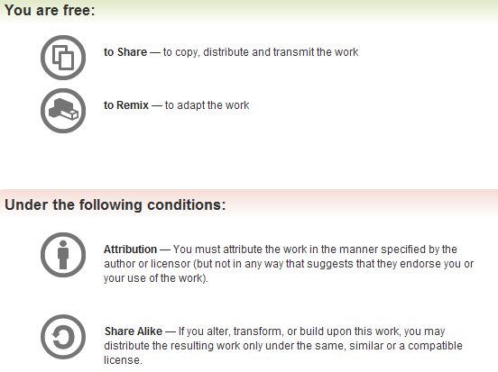
All materials is licensed under a Creative Commons “Share Alike” license.
http://creativecommons.org/licenses/by-sa/3.0/

Slide 3
# whoami
Ali Al-Shemery
Ph.D., MS.c., and BS.c., Jordan
More than 14 years of Technical Background (mainly Linux/Unix and Infosec)
Technical Instructor for more than 10 years (Infosec, and Linux Courses)
Hold more than 15 well known Technical Certificates
Infosec & Linux are my main Interests

Slide 4
Software Exploitation
Prepared by:
Dr. Ali Al-Shemery
Mr. Shadi Naif

Slide 5
Debugging Fundamentals for Pentesters

Slide 6
Outline – Part 2
Debugger
  GDB
  Immunity Debugger
Debuggers Offer?
Popular Debuggers?
Which to use?
Example: Debugging auth.c using gdb

Slide 7
Debugger
A computer program that lets you run your program, line by line and examine the values of variables or look at values passed into functions and let you figure out why it isn't running the way you expected it to.

Slide 8
Debuggers Offer?
Debuggers offer sophisticated functions such as:
  Running a program step by step (single-stepping mode),
  Stopping (breaking) (pausing the program to examine the current state) at some event or specified instruction by means of a breakpoint,
  Tracking the values of variables,
  Tracking the values of CPU registers,
  Attach to a process,
  View the process’s Memory map,
  Load memory dump (post-mortem debugging),
  Disassemble program instructions,
  Change values at runtime,
  Continue execution at a different location in the program to bypass a crash or logical error.

Slide 9
Popular Debuggers?
GNU Debugger (GDB)
Microsoft Windows Debugger (Windbg)
OllyDbg
Immunity Debugger
Microsoft Visual Studio Debugger
Interactive Disassembler (IDA Pro)

Slide 10
Immunity Debugger
A powerful new way to write exploits, analyze malware, and reverse engineer binary files.
It builds on a solid user interface with function graphing, and a large and well supported Python API for easy extensibility.
Did you read that? Python ☺

Slide 11
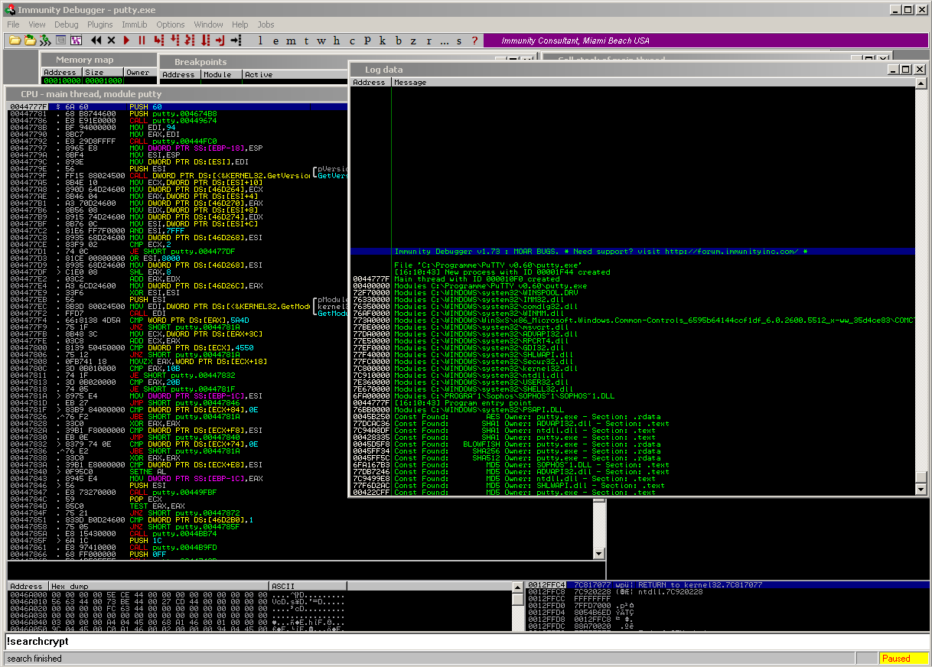
Immunity Debugger

Slide 12
Which to use?
IMO there is no exact answer to this question, it’s a matter of comfort!
Choose the debugger comfortable for you and helps you with your debugging process.

Slide 13
Example – Auth.c
What does auth.c do?
  It takes the first argument from the command line,
  It then passes this argument to a basic authentication function for checking,
  If the argument is the correct password, it prints a success message,
  If the argument isn’t the correct password, it prints a failure message.
There is a bug in the code!
Let’s try to discover it.

Slide 14
Auth.c using gdb
gdb is a command line debugger, not very user friendly, but very powerful.
First we need to compile auth.c, then run auth from within gdb.
Use gcc:
  gcc –ggdb –O0 auth.c -o auth

Slide 15
Auth.c using gdb - Cont.
Start auth from within gdb:
  gdb auth
Run it with no arguments
  (gdb) run
This will give us a Segmentation fault.
The program now crashes!
Let’s find what made the program crash.

Slide 16
Auth.c using gdb - Cont.
We need to reconstruct the frames on the stack.
The frames will show us the function calling sequence.
Use the gdb command “backtrace”
  (gdb) backtrace
If you examine the output of the command you will find that the crash happened after calling the auth() function (frame #1)!

Slide 17
Auth.c using gdb - Cont.
We need to check the instructions in the code where it has crashed.
EIP points to the last instruction executed.
We need to examine the memory and EIP:
To do that we will use the “x” to display memory contents:
  (gdb) x/5i $eip
What does all that do????

Slide 18
Auth.c using gdb - Cont.
“x” is used to display memory content in various formats,
“i” is used for displaying instructions (disassembly),
“5” is the number of instructions to display.
Check next slide for “x” formats.

Slide 19
“x” – Examine Memory
x / <count> <format> <unit>
Format | Description
x | hexadecimal
d | decimal
o | octal
t | binary
i | instructions
s | string
c | character
u | unsigned
Unit | Description
b | bytes
w | words (4 bytes)

Slide 20
Auth.c using gdb - Cont.
The fault occurred at this instruction:
  (gdb) x/10i $eip
  cmp al, BYTE PTR [edx]
cmp al, BYTE PTR [edx] compares al with the byte at the memory address stored within edx.
There doesn’t seem to be an error here!
Wait, let’s inspect the register edx and see what does it hold?

Slide 21
Auth.c using gdb - Cont.
Let’s inspect the local variables and arguments.
We can use the gdb “info locals” and “info args” commands:
(gdb) info locals
No symbol table info availabe
(gdb) info args
No symbol table info availabe

Slide 22
Auth.c using gdb - Cont.
That means there is no debugging information. (Re-compile to resolve!)
Quit gdb:
(gdb) q
Recompile with debugging information enabled:
gcc –g auth.c –o auth
The –g informs the compile to include symbolic debugging information within the compiled binary.

Slide 23
Auth.c using gdb - Cont.
Let’s load auth in gdb again:
  $ gdb auth
Now we can list the program code which is available from the debugging information.
For that we use the gdb “list” command:
  (gdb) list
  Press Enter if not all the code is shown.

Slide 24
Auth.c using gdb - Cont.
If you remember the program crashed when calling the auth() function.
Let us setup a break point. We can use the gdb “break” command:
  (gdb) break 13
Now run the program:
  (gdb) run
The process execution is suspended when it reaches our breakpoint. This is how we made gdb control the execution process!

Slide 25
Auth.c using gdb - Cont.
Let us check the arguments values.
We can use the gdb “print” command for inspecting variables.
  (gdb) print argv[1]
argv[1] is the argument passed to the auth function. And as you can see it’s value is 0x0 which is a NULL pointer!
Continue the execution with the gdb command “continue”:
  (gdb) continue

Slide 26
Auth.c using gdb - Cont.
Now if we inspect the registers using the gdb command “info registers” we see that edx is holding 0x0 (the NULL pointer).
  (gdb) info registers
  (gdb) x/5i $eip
This is what is causing the crash, as the program is comparing to a NULL pointer!

Slide 27
Auth.c using gdb – Summary
Using gdb we managed to discover the bug in our code.
All we need to do to solve this problem is check for the number of given arguments before calling the auth() function!
as simple as that!

Slide 28
Load Configurations
Tired of always setting your GDB configurations?
Use the -x file
Add your configurations to a file such as gdb.config and then:
  gdb –x gdb.config auth

Slide 29
Quit GDB Debugging
Just press ‘q’ !

Slide 30
References (1)
Papers/Presentations/Links:
  ShellCode, http://www.blackhatlibrary.net/Shellcode
  Introduction to win32 shellcoding, Corelan, http://www.corelan.be/index.php/2010/02/25/exploit-writing-tutorial-part-9-introduction-to-win32-shellcodeing/
  Hacking/Shellcode/Alphanumeric/x64 printable opcodes, http://skypher.com/wiki/index.php/Hacking/Shellcode/Alphanumeric/x64_printable_opcodes
  Learning Assembly Through Writing Shellcode, http://www.patternsinthevoid.net/blog/2011/09/learning-assembly-through-writing-shellcode/
  Shellcoding for Linux and Windows Tutorial, http://www.vividmachines.com/shellcode/shellcode.html
  Unix Assembly Codes Development, http://pentest.cryptocity.net/files/exploitation/asmcodes-1.0.2.pdf
  Win32 Assembly Components, http://pentest.cryptocity.net/files/exploitation/winasm-1.0.1.pdf

Slide 31
References (2)
Papers/Presentations/Links:
  64-bit Linux Shellcode, http://blog.markloiseau.com/2012/06/64-bit-linux-shellcode/
  Writing shellcode for Linux and *BSD, http://www.kernel-panic.it/security/shellcode/index.html
  Understanding Windows’s Shellcode (Matt Miller’s, aka skape)
  Metasploit’s Meterpreter (Matt Miller, aka skape)
  Syscall Proxying fun and applications, csk @ uberwall.org
  X86 Opcode and Instruction Reference, http://ref.x86asm.net/
  Shellcode: the assembly cocktail, by Samy Bahra, http://www.infosecwriters.com/hhworld/shellcode.txt

Slide 32
References (3)
Books:
  Grayhat Hacking: The Ethical Hacker’s Handbook, 3rd Edition
  The Shellcoders Handbook,
  The Art of Exploitation, 2nd Edition,
Shellcode Repositories:
  Exploit-DB: http://www.exploit-db.com/shellcodes/
  Shell Storm: http://www.shell-storm.org/shellcode/
Tools:
  BETA3 - Multi-format shellcode encoding tool, http://code.google.com/p/beta3/
  X86 Opcode and Instruction Reference, http://ref.x86asm.net/
  bin2shell, http://blog.markloiseau.com/wp-content/uploads/2012/06/bin2shell.tar.gz

