Slide 1
CISSP® Common Body of Knowledge Review:
Physical (Environmental) Security Domain
Version: 5.10

Slide 2
Learning Objective
Physical (Environmental) Security Domain
The Physical (Environmental) Security domain addresses the threats, vulnerabilities, and countermeasures that can be utilized to physical protect an enterprise’s resources and sensitive information. These resources include people, the facility in which they work, and the data, equipment, support systems, media, and supplies they utilize.
Physical security describes measures that are designed to deny access to unauthorized personnel (including attackers) from physically accessing a building, facility, resources, or stored information; and guidance on how to design structures to resist potentially hostile acts.
The candidate is expected to know the elements involved in choosing a secure site, its design and configuration, and the methods for securing the facility against unauthorized access, theft of equipment and information, and the environmental and safety measures needed to protect people, the facility, and its resources.
Reference: CISSP CIB, January 2012 (4.17.14 Rev. 13)

Slide 3
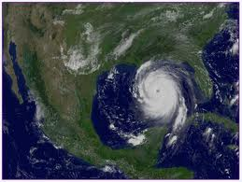
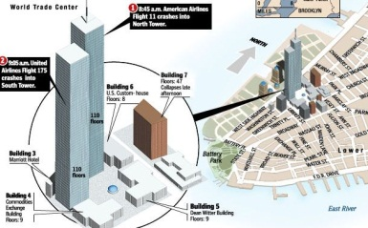
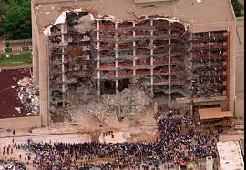
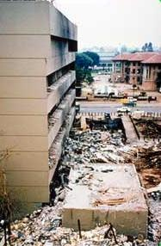
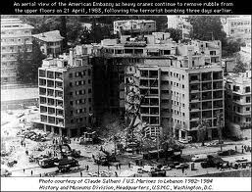
Lessons-Learned for U.S.
Major Domestic Events:
  2005 Hurricane Katrina (1,836)
  2001 9/11 Attack: World Trade Center, Pentagon, and Shanksville, PA (2,982)
  1995 Federal Office Building, Oklahoma City (168)
Major International Events:
  1998 U.S. Embassy, Kenya (237)
  1983 Beirut Barracks, Lebanon (309)
Reference:
List of Terrorist Attacks, Wikipedia (http://en.wikipedia.org/wiki/List_of_battles_and_other_violent_events_by_death_toll#Terrorist_attacks)

Slide 4
References for Physical Security
Interagency Security Committee (ISC)
  Facility Security Level Determinations for Federal Facilities (21 February 2008)
  Physical Security Criteria for Federal Facilities (12 April 2010)
  Design-Basis Threat (12 April 2010)
  The Use of Physical Security Performance Measures (June 2009)
Department of Defense (DoD)
  Unified Facility Criteria (UFC) 4-010-01, Minimum Antiterrorism Standards for Buildings (22 January 2007)
  UFC 4-020-01, DoD Security Engineering Facility Planning Manual
Department of State (DoS)
  OBO-ICS 2009, Overseas Building Operations International Code Supplement
Commercial Facilities
  Crime Prevention Through Environmental Design (CPTED)
  Structural Design for Physical Security, State of the Practice, Structural Engineering Institute, American Society of Civil Engineers (ASCE)
Reference:
Security for Building Occupants and Assets, National Institute of Building Science (http://www.wbdg.org/design/provide_security.php)

Slide 5
Topics
Physical Security Domain
Terms & Definition
Type of Threats and Information Protection Environment
Security Countermeasures & Technologies

Slide 6
Concept & Definition
Categories of Security Controls
Management (Administrative) Controls
  Policies, Standards, Processes, Procedures, & Guidelines
    Administrative Entities: Executive-Level, Mid.-Level Management
Physical Controls
  Physical Security (Facility or Infrastructure Protection)
    Locks, Doors, Walls, Fence, Curtain, etc.
    Service Providers: FSO, Security Guards, Dogs
Technical (Logical) Controls
  Access Controls , Identification & Authorization, Confidentiality, Integrity, Availability, Non-Repudiation.
    CCTV & Camera, IDS, Moisture detection system, Fire/Smoke detection system, Fire suppression, Environmental control system, UPS, etc.
    Service Providers: Building Architect, Critical Infrastructure Protection (CIP) Engineer, Operations Center.

Slide 7
Concept & Definition
Types of Security Controls
Directive controls: Often called administrative controls, these are intended to advise employees of the behavior expected of them during their interfaces with or use the organization’s information systems.
Preventive controls: Included in preventive controls are physical, administrative, and technical measures intended to preclude actions violating policy or increasing risk to system resources.
Deterrent controls: Deterrent controls involve the use of warnings of consequences to security violations.
Detective controls: Detective controls involve the use of practices, processes, and tools that identify and possibly react to security violations.
Corrective controls: Corrective controls also involve physical, administrative, and technical measures designed to react to detection of an incident in order to reduce or eliminate the opportunity for the unwanted event to recur.
Recovery controls: Once an incident occurs that results in the compromise of integrity or availability, the implementation of recovery controls is necessary to restore the system or operation to a normal operating state.
Notes:
Ref. 5.3 Security Technology and Tools, Page 340.

Slide 8
Topics
Physical Security Domain
Terms & Definition
Type of Threats and Information Protection Environment
Security Countermeasures & Technologies

Slide 9
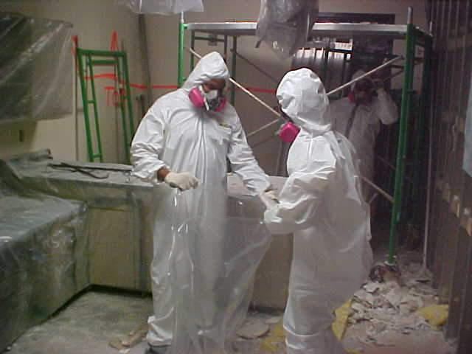
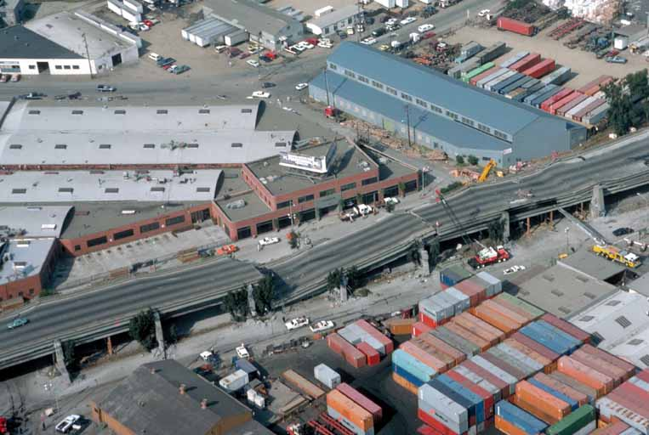
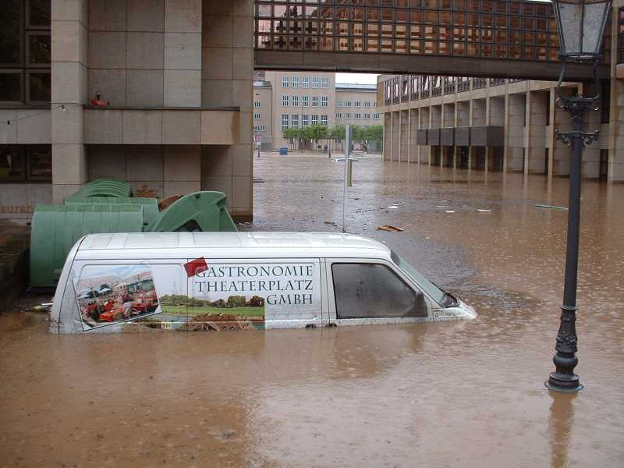
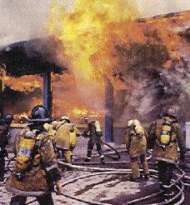
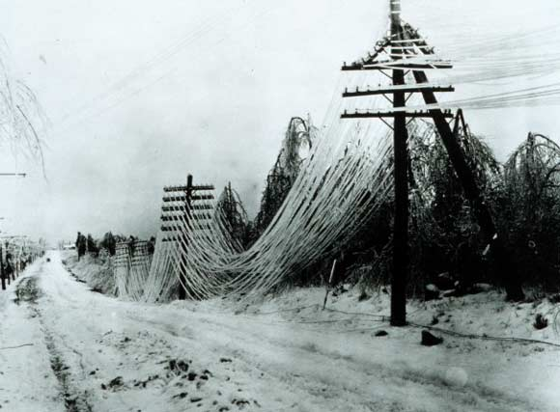
Type of Threats and Information Protection Environment
Type of Threats to Physical Environment
Natural / Environmental
  Earthquakes, floods, storms, hurricanes, fires, snow/ice
  Consequence of natural phenomena
Man made / Political Events
  Explosives, disgruntled employees, unauthorized access, employee errors, espionage, arson/fires, sabotage, hazardous/toxic spills, chemical contamination, malicious code, vandalism and theft
  Acts of commission or omission

Slide 10
Type of Threats and Information Protection Environment
Lessons-Learned for U.S.
Major Domestic Events:
  2005 Hurricane Katrina (1,836)
  2001 9/11 Attack: World Trade Center,
  Pentagon, and Shanksville, PA (2,982)
  1995 Federal Office Building,
  Oklahoma City (168)
Major International Events:
  1998 U.S. Embassy, Kenya (237)
  1983 Beirut Barracks, Lebanon (309)
Reference:
List of Terrorist Attacks, Wikipedia (http://en.wikipedia.org/wiki/List_of_battles_and_other_violent_events_by_death_toll#Terrorist_attacks)

Slide 11
Example References for Physical Security
Interagency Security Committee (ISC)
  Facility Security Level Determinations for Federal Facilities (21 February 2008)
  Physical Security Criteria for Federal Facilities (12 April 2010)
  Design-Basis Threat (12 April 2010)
  The Use of Physical Security Performance Measures (June 2009)
Department of Defense (DoD)
  Unified Facility Criteria (UFC) 4-010-01, Minimum Antiterrorism Standards for Buildings (22 January 2007)
  UFC 4-020-01, DoD Security Engineering Facility Planning Manual
Department of State (DoS)
  OBO-ICS 2009, Overseas Building Operations International Code Supplement
Commercial Facilities
  Crime Prevention Through Environmental Design (CPTED)
  Structural Design for Physical Security, State of the Practice, Structural Engineering Institute, American Society of Civil Engineers (ASCE)
  And many others…
Reference:
Security for Building Occupants and Assets, National Institute of Building Science (http://www.wbdg.org/design/provide_security.php)

Slide 12
Security Countermeasures & Technologies
Security Objectives & Controls
Safeguarding and protecting physical assets against damage, lost, or theft from natural/environmental and man-made/political events.
Administrative controls
  Facility location, construction, and management.
  Physical security risks, threats, and countermeasures.
Technical controls
  Authenticating individuals and intrusion detection.
  Electrical issues and countermeasures.
  Fire prevention, detection, and suppression.
Physical controls
  Perimeter & Building Grounds.
  Building Entry Point.
  Box-within a box Floor Plan.
  Data Centers or Server Room Security.

Slide 13
Topics
Physical Security Domain
Terms & Definition
Type of Threats and Information Protection Environment
Security Countermeasures & Technologies

Slide 14
Security Countermeasures & Technologies
Strategic Approach to Physical Security …(1/2)
Facility location, construction, and management using Crime Prevention through Environmental Design (CPTED)
  Natural Surveillance
    Architectural features that maximizes visibility of people, parking areas, and building entrances.
  Territorial Reinforcement
    Architectural features that distinguishes private and public spaces (e.g., fences, gateways, and landscape, etc.)
  Natural Access Control
    Structural elements that discourages access to private areas (e.g., streets, signs, and landscape, etc.)
  Target Hardening
    Architectural elements that prohibits unauthorized accesses (e.g., door locks, window locks, interior door hinges, etc.)
Reference: http://cpted-watch.com

Slide 15
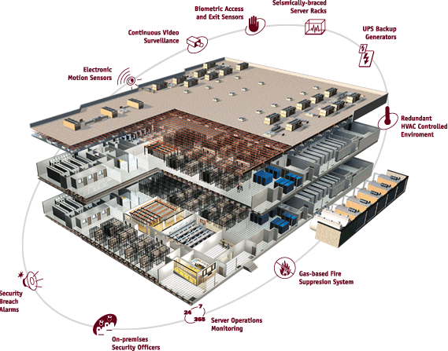
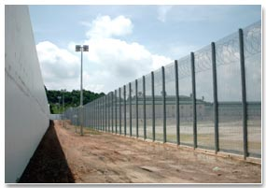
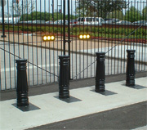
Security Countermeasures & Technologies
Strategic Approach to Physical Security …(2/2)
Defense-in-depth
Source: Global Crossing website

Slide 16
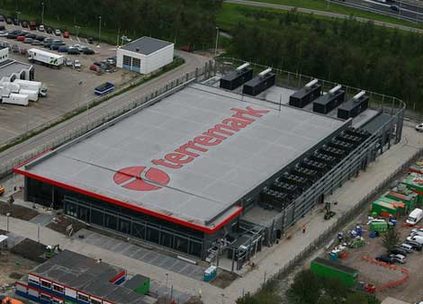
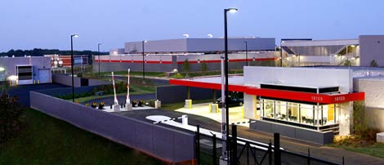
Reference:
Verizon-Terremark (http://www.datacenterknowledge.com/archives/2011/04/11/verizon-completes-acquisition-of-terremark/)

Slide 17
Examples of Design Failure

Slide 18
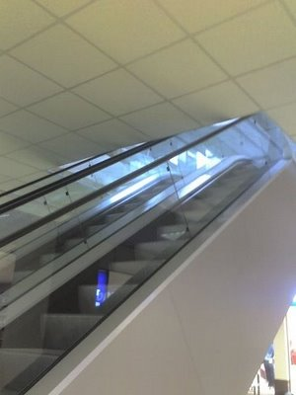
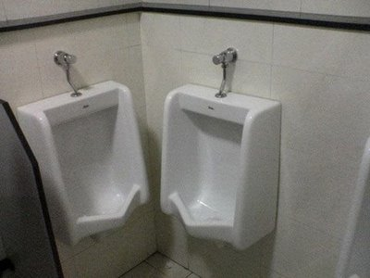
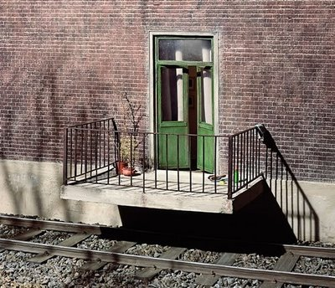
More Examples of Design Failure

Slide 19
Security Countermeasures & Technologies
Design Process
Similar to information system, physical security system also uses SDLC process…
Development of physical security system starts with Business /Mission needs.

Slide 20
Security Countermeasures & Technologies
Defining Business/Mission Needs
Security considerations for building location and how it should be built.
  Natural disasters?
  Adjacent buildings?
  Crime?
  Riots?
  Airport?
  Highway?
  Power source?
  Water source?
  Emergency support?
  Fire station?
  Hospital?

Slide 21
Security Countermeasures & Technologies
Plan and Define Physical Security Requirements
Perform critical-path analysis for site location, construction impacts, and facility impacts.
  Lists all elements of physical security and how they interact and how they are interdependent.
    (i.e. power, data, water, A/C, generators, storm drains, and sewer lines).
  Path that is critical for business functionality.
  Alignment to business continuity, COOP, and disaster recovery goals.
    Business impact analysis (BIA).
    Information sensitivity or classification.
  Consider laws and regulations.
  (e.g. building codes, fire codes, etc.)
Notes:
Redundant paths should be shown and there should be at least one redundant path for every critical path.

Slide 22
Security Countermeasures & Technologies
Facility – Location
Location Considerations
  Natural disasters (i.e. floods, tornadoes, earthquakes, or hurricanes.)
  Hazardous terrain (i.e. mudslide, excessive snow or rainfall.)
  Surrounding area and external entities
    Local crime rate / Riots.
    Proximity to police, medical, and fire stations.
    Potential hazards from surrounding area.
  Accessibility
    Road access.
    Excessive traffic.
    Proximity to airports, train stations, and
    highways.
  Visibility
    Building markings and signs.
    High or low population in the area.
    Types of neighbors.

Slide 23
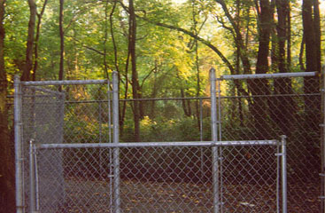
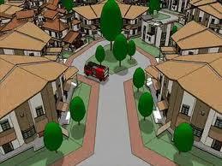
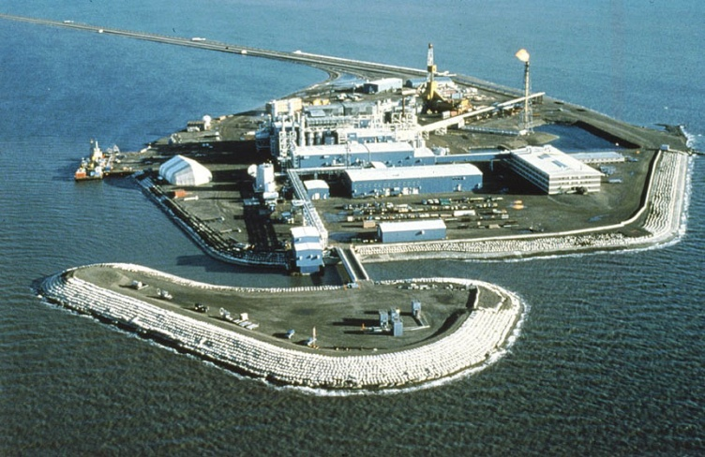
Security Countermeasures & Technologies
CPTED – Natural Access Control
Terrain
  Distance from fenced boundary to building. Distance to adjacent building or structure.
  Roadway and paths to building(s).
Landscaping
  Spiny shrubs and/or trees
  Grass, sod or gravel traps
  Water (i.e. drainage pond, lake or stream)

Slide 24
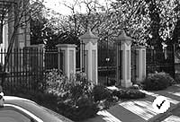
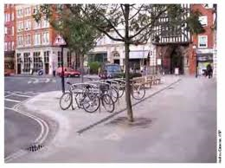
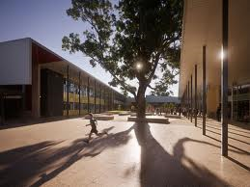
Security Countermeasures & Technologies
CPTED – Natural Surveillance
Use and placement of physical environmental features, personnel walkways, and activity areas in ways that maximize visibility
Open stairways
Make employees feel safe and intruders feel uncomfortable

Slide 25
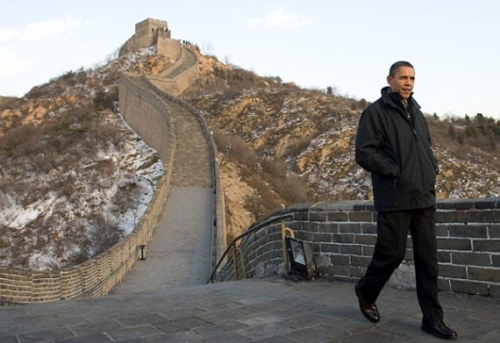
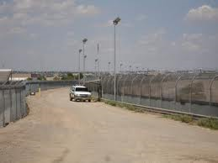
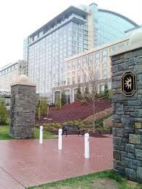
Security Countermeasures & Technologies
CPTED – Territorial Reinforcement
Physical designs that emphasize or extend the company’s physical sphere of influence so that legitimate users feel a sense of ownership of that space
Use walls, fences, flags, etc.
Create a sense of dedicated community

Slide 26
Security Countermeasures & Technologies
CPTED – Target Hardening
Building access controls
  Entry/ exit points
  Windows and doors
  Interior partitions (e.g., walls, ceilings, and floors, etc.)
  Locks
  Intrusion detection
Utilities
  Power sources: primary and backup
  Water sources and sewage
Air conditioning
  Heating & cooling
  Humidity control
Fire controls
  Detection and mitigation

Slide 27
Security Countermeasures & Technologies
Administrative Controls
Physical security policies & procedures
  Response measures and procedures
    Integration with business continuity, COOP, and disaster recovery plans.
    Periodic inspections and reports.
    Awareness training, testing and drills.
  Risk Management processes
    Risk assessment to identify threats and threat agents
    Risk mitigation to plan for change and update baseline
    Risk evaluation to verify & validate countermeasures.
  Security audits & assessments
    Review audit trails of entries and exits.
    Perform assessments using walkthrough (desktop exercise), checklist, simulation, or full-interrupt test.

Slide 28
Security Countermeasures & Technologies
Administrative Controls
Security guards are used for making complex decisions:
  Checking credentials at entry points.
  Ensuring company property does not leave facility.
  Monitor intrusion detection and fire alarm systems.
  Verify doors and windows are locked.
  Watching for suspicious activity.
  Watch for piggybacking.
  Should not stay stationary – may have a post and one roving guard.
  Personnel is the most expensive countermeasure to reduce physical security risks.

Slide 29
Security Countermeasures & Technologies
Physical Controls – Facility Construction
Structured barriers: Perimeter structure
Walls & Fencing
  Specific gauge and fabrication specifications (e.g. No. 11 gauge galvanized chain-link fencing material.)
  Specify height, or need for “top guard” (e.g. 8-ft in height, 6-in. under ground with top guard.)
Height | Protection
1 meter / 3 – 4 ft | Deters casual trespassers
2 meter / 6 – 7 ft | Too high to climb easily
2.4 meter / 8 ft with top guard | Deters determined intruder
Source: Official (ISC)² Guide to The CISSP Exam

Slide 30
Security Countermeasures & Technologies
Physical Controls – Facility Construction
Structured barriers: Entry points
  Gates, bollards, roadways.
  Doors, windows, ventilation airways, manhole covers, etc.
  Department of State and DoD Anti-Ram Vehicle Barrier Certification Criteria (SD-STD-02.01):
Vehicle Weight: 15,000 lb.
Speed Rating | Speed at Impact
K4 | 30 mph
K8 | 40 mph
K12 | 50 mph
Vehicle Weight: 15,000 lb.
Penetration Rating | Penetration Distance
L3 | < 3 ft
L2 | 3 – 20 ft
L1 | 20 – 50 ft
Reference: http://www.probarrier.com/faq/certify.asp

Slide 31
Security Countermeasures & Technologies
Physical Controls – Facility Construction
Structured barriers: Standard for vehicular gates (UL Standard 325)
  Class I: Residential gate operation
  Class II: Commercial, such as a parking lot or garage
  Class III: Industrial/ limited access, such as a warehouse, factory, or loading doc
  Class IV: Restricted access operation that requires supervision by security personnel, such as those at a prison or airport security area
Reference: Official (ISC)2 Guide to The CISSP Exam

Slide 32
Security Countermeasures & Technologies
Physical Controls – Facility Construction
Structured barriers: Construction materials
  Exterior / interior walls (i.e. structural, sound, and TEMPEST.)
  Windows (e.g. structural, exposure to sun light, size & height.)
  Ceiling, roof, and floor (e.g. structural, and access.)
  Structural (i.e. earthquake proofing, and fire resistance.)
Reference: Official (ISC)2 Guide to The CISSP Exam

Slide 33
Security Countermeasures & Technologies
Physical Controls
Lighting
  Provide deterrent to intruders and to assist other access control systems.
  Types of lighting systems:
    Continuous lighting: A series of fixed luminaries arranged to flood a given area continuously
    Trip lighting: Activated when intruder crosses a sensor
    Standby lighting: Similar to continuous lighting, except luminaries are not continuously lit
    Emergency lighting: Activated in emergency events (e.g. power failure or fire)
  Types of lighting:
    Glare projection lighting: To a specific area and deter intruder actions
    Flood light: To a large area to facilitate security monitoring
Reference: Official (ISC)2 Guide to The CISSP Exam

Slide 34
Questions:
What is the primary rationale for having a security guard?
What are the three types of structured barrier that provide physical protection of assets within a facility?
What are the two type of natural barrier that provide physical protection of assets within a facility?

Slide 35
Answers:
What is the primary rationale for having a security guard?
  To make complex decision
What are the three types of structured barrier that provide physical protection of assets within a facility?
  Perimeter structures
  Entry point controls
  Construction material
What are the two type of natural barrier that provide physical protection of assets within a facility?
  Terrain
  Landscaping

Slide 36
Questions:
What is the minimum fencing requirement for deterring a determined intruder?
What is the minimum entry point barrier standard that would stop a 15k lb (or 7 ton) truck at 30 mph?
What are the two primary purposes for lighting?

Slide 37
Answers:
What is the minimum fencing requirement for deterring a determined intruder?
  8 ft with top guard
What is the minimum entry point barrier standard that would stop a 15k lb (or 7 ton) truck at 30 mph?
  K4 (for 30 mph), K8 (for 40 mph), K12 (for 50 mph)
What are the two primary purposes for lighting?
  Deter intruders
  Assist in identification of intruders

Slide 38
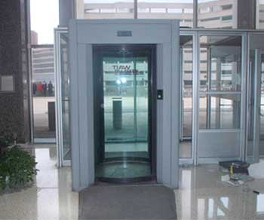
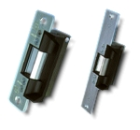
Security Countermeasures & Technologies
Technical Controls – Entrance Protection
Entry access control systems
Turnstiles
  Revolving doors that can be activated to “lock” and not allow unauthorized individuals to enter or leave facility
  To prevent “piggybacking”.
Mantraps
  Routing people through two stationary
  doorways
Fail-safe
  Door defaults to being unlocked.
Fail-secure
  Door defaults to being locked.

Slide 39

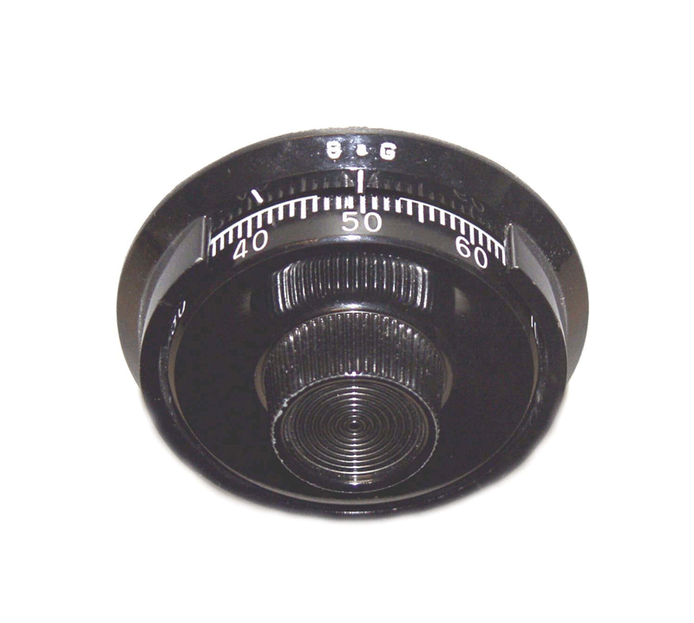
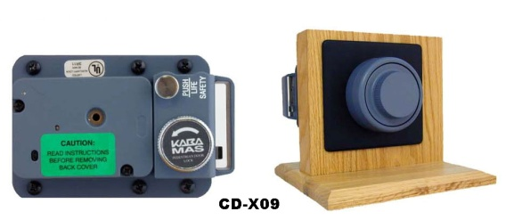
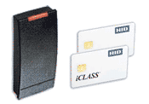

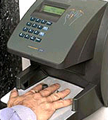
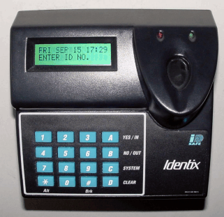
Security Countermeasures & Technologies
Technical Controls
Entry access control systems – Locks
Mechanical locks:
  Key
  Combination locks
  Magnetic locks
Electronic locks:
  Combination lock
  Proximity / RFID badge
  Bio-metric

Slide 40
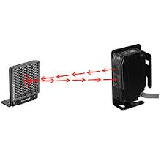
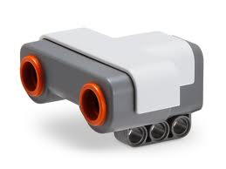
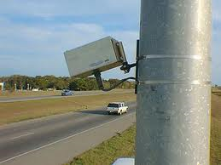
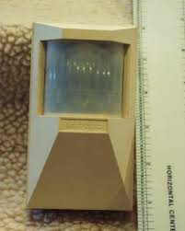
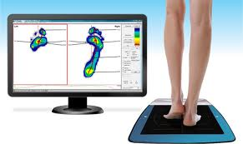
Security Countermeasures & Technologies
Technical Controls
Intrusion detection & surveillance systems
IDS: Sensors that detect access into a controlled area:
  Photoelectric
  Ultrasonic
  Microwave
  Passive infrared
  Pressure sensitive

Slide 41

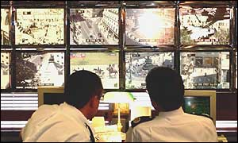
Security Countermeasures & Technologies
Technical Controls – Intrusion Detection & Surveillance Systems
Closed-circuit television (CCTV)
  Detect the presence of an object.
  Recognition of object type.
  Identification of object details.

Slide 42
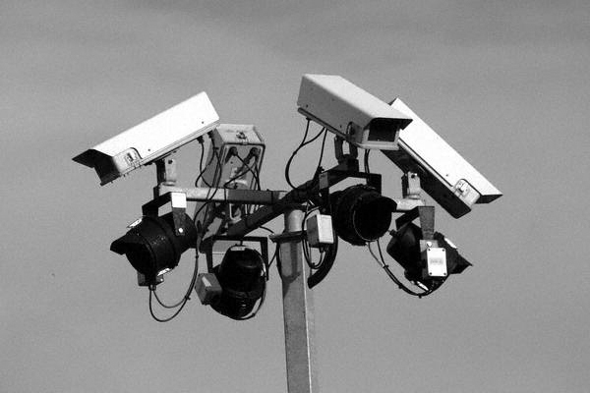
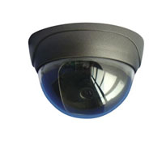
Security Countermeasures & Technologies
Technical Controls – Surveillance Systems
CCTV camera considerations
  Charge-coupled device (CCD) converts pixels into data signals
  Cathode ray tube (CRT) converts picture image into data signals
  Field-of-view is the area that can be captured by the camera lens.
  Depth-of-field is the area between the nearest and farthest points that appear to be in focus.
  Monochrome or color camera.

Slide 43
Security Countermeasures & Technologies
Technical Controls – Electrical Power Supply
Risks to electrical power supply:
  Blackout: complete loss of commercial power
  Fault: momentary power outage
  Brownout: an intentional reduction of voltage by
  a power company.
  Sag/dip: a short period of low voltage
  Surge: a sudden rise in voltage in the power supply.
  In-rush current: the initial surge of current required by a load before it reaches normal operation.
  Transient: line noise or disturbance is superimposed on the supply circuit and can cause fluctuations in electrical power

Slide 44
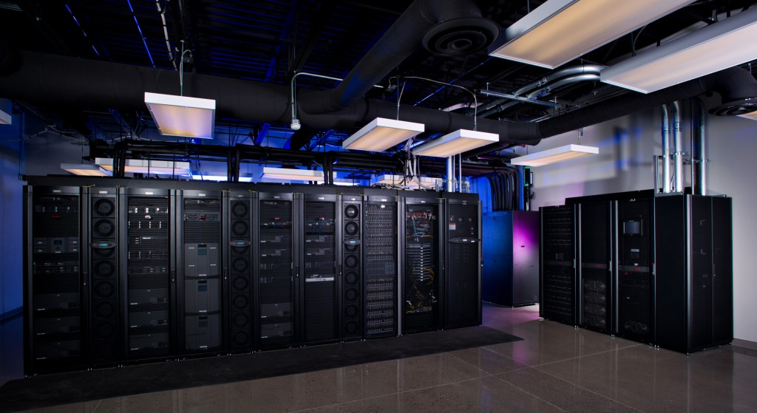
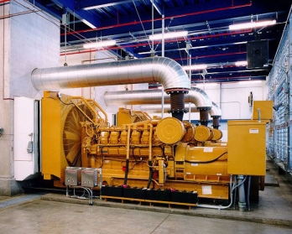
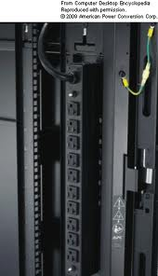
Security Countermeasures & Technologies
Technical Controls – Electrical Power Supply
Counter measures to electrical power supply risks:
  Uninterruptible power supply (UPS) (include transfer switch, battery, transformer, generator, circuit switch, and power distribution unit (PDU))
    For blackout and fault
  Surge protector, circuit breaker, transformer, and UPS
    For brownout, sag/dip, surge, in-rush current, and transient

Slide 45
Security Countermeasures & Technologies
Technical Controls – Electrostatic Discharge
Risk of electrostatic discharge:
  A type of electrical surge can occur when two non-conducting materials rub together, causing electrons to transfer from one material to another.
Countermeasures: Anti-electrostatic discharge (ESD) standards
  Grounding of equipment to a common point ground.
  Grounding of personnel: wrist strap, flooring, clothing and footwear.
  Protected area: Flooring, seating, ionization of air, and humidity control.
  Marking of equipment, package and facility.
  Example: Data center: grounding of rack & floors to a common point ground, raised floor tiles have conductive gold leafs to supporting frame to dissipate ESD.

Slide 46
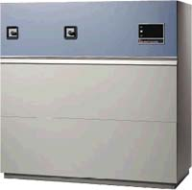
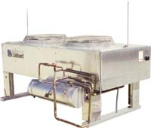
Security Countermeasures & Technologies
Technical Controls – Heating, Ventilating and Air Conditioning (HVAC)
Types of HVAC systems:
  Up-flow (forced air above the floor) vs. down-flow (forced air below the raised floor).
  Water or Glycol.
HVAC considerations:
  Air volume cubic feet per
  minute (CFM) per ton.
  Humidity control (RH 45% - 60%).
  Temperature control (72°F ± 2°F).
  Air Filters.
  Positive air pressure.
  Protected intake vents.
  Alarms: Leak detection, loss of power,
  temperature, humidity, fire, smoke detector.

Slide 47
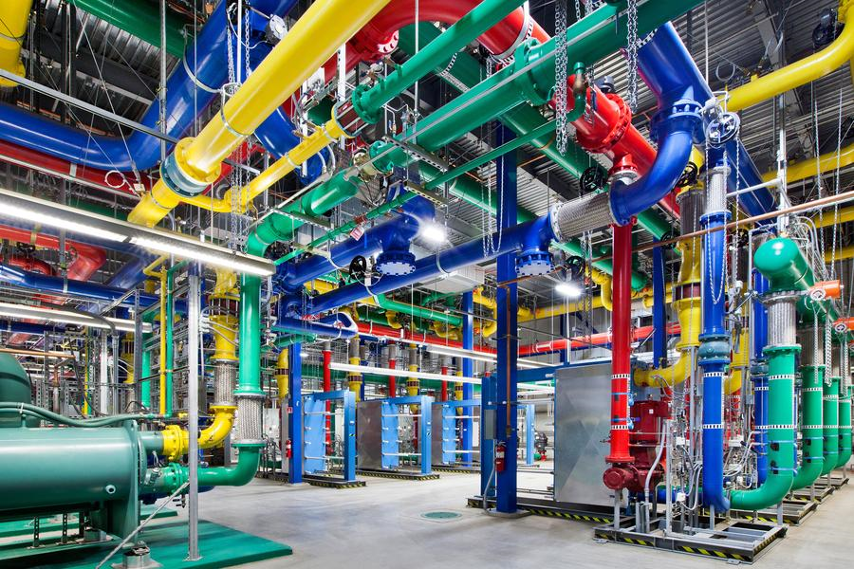
Security Countermeasures & Technologies
Technical Controls – Water Supply System
For cooling, plumbing, sewage, and fire-suppression (outside of server room).
Water source.
Water usage.
  Volume of water.
  Water filtration.
  Environmental impact.
Water pump to maintain
pressure.

Slide 48
Security Countermeasures & Technologies
Technical Controls – Types of Fire
Fire Class | Type of Fire | Elements of Fire | Suppression Method
Class A | Common Combustibles | Ashes, paper, wood, cloth, etc. | Water, Soda acid
Class B | Liquid | Barrels of oils, Petroleum, tars, solvents, alcohol, gases | Halon, CO₂, FM-200
Class C | Electrical | Circuits, electrical equipment, and wires | Halon, CO₂ , or Non-conductive extinguishing agent – FM-200
Class D | Dry Chemical | Combustible metals, and chemical | Dry Powder, Halon
Class K | Commercial Kitchen | Food, Grease | Wet Chemicals - Foam

Slide 49
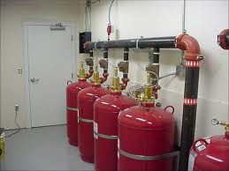
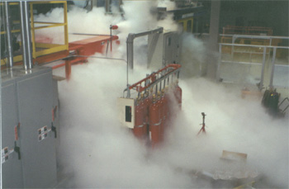

Security Countermeasures & Technologies
Technical Controls – Fire Suppression Systems
Halon
  Used so that equipment is not damaged by water.
FM-200
  Replacement for Halon without ozone depleting chemicals.
  It uses chemicals instead of water.
Carbon Dioxide
  Does not leave reside after use, does not cause damage to sensitive devices.
  Can suffocate people.
Dry Chemicals
  Not effective against electrical fires.

Slide 50


Security Countermeasures & Technologies
Technical Controls – Fire Suppression Systems
Special note on fire suppression systems…
Halon
  Halon has been banned for all new fire suppression systems under the 1987 Montreal Protocol on Substances that Deplete the Ozone Layer.
    Began implementation in 1992. All new installations of fire suppression systems must use alternate options.
“Pre-action” or dry-pipe fire suppression system
  Water is held back remotely by a valve that is actuated by a sensing system.
Deluge fire suppression system
  Same as dry pipe except the
  sprinkler head is open.
  Releases a lot of water fast.
  Usually not used in data processing environments.
Temperature | Color
155° F | Red
174° F | Yellow
200° F | Green

Slide 51


Security Countermeasures & Technologies
Technical Controls – Fire Suppression Systems
Dry Pipe:
  No water standing in the pipe
  Air is blown out and water is released
  Time delay can allow systems to properly power down
Reference: Fundamentals of Fire Fighter Skills, International Association of Fire Chiefs, 2008

Slide 52

Security Countermeasures & Technologies
Technical Controls – Fire Suppression Systems
Pre-action:
  Form of dry pipe system
  Has a secondary device such as smoke detector or manual-pull alarm
  Requires activation of the secondary device before water is released
Reference: Fundamentals of Fire Fighter Skills, International Association of Fire Chiefs, 2008

Slide 53



Security Countermeasures & Technologies
Technical Controls – Fire/ Smoke Detection
Ionization-type smoke detector detect
charged particles in smoke.
Optical (photoelectric) smoke detectors
react to light blockage because of smoke.
Fixed or rate-of-rise temperature sensor.

Slide 54
Questions:
Turnstiles access control system prevents?
What is the difference between fail-safe door and a fail-secure door?
What are the two types of error rate for bio-metric access control systems?

Slide 55
Answers:
Turnstiles access control system prevents?
  “Piggybacking”
What is the difference between fail-safe door and a fail-secure door?
  Fail-safe defaults to being unlocked
  Fail-secure defaults to being locked
What are the two types of error rate for bio-metric access control systems?
  False rejection (Type I Error)
  False acceptance (Type II Error)

Slide 56
Questions:
What is the term for describing a complete loss of commercial power?
What is the term for describing a sudden rise of voltage in the power supply?
What is the term for describing a momentary power outage?

Slide 57
Answers:
What is the term for describing a complete loss of commercial power?
  Blackout
What is the term for describing a sudden rise of voltage in the power supply?
  Surge
What is the term for describing a momentary power outage?
  Fault

Slide 58
Questions:
How humidity control can reduce the risk of electrostatic discharge?
What class of fire is caused by electrical elements?
Why type of fire suppression system were the water is held back remotely by an actuator?
What type of fire suppression system releases a lot of water fast?

Slide 59
Answers:
How humidity control can reduce the risk of electrostatic discharge?
  By reduce ionization of air particles
What class of fire is caused by electrical elements?
  Class C
Why type of fire suppression system were the water is held back remotely by an actuator?
  Dry-pipe (a.k.a. pre-action)
What type of fire suppression system releases a lot of water fast?
  Deluge

Slide 60
Validation Time… ☺
Classroom Exercise
Review Answers

Slide 61
Exercise #1: Electrical Utility Definition
Electrical Power Terminology | Description
Fault
Blackout
Sag/Dip
Brownout
Spike
Surge
Inrush Current
Noise
Transient Noise
Clean
Ground

Slide 62


Exercise #2: What do you think it might be missing?

Slide 63
Answers
Suggested

Slide 64
Exercise #1: Electrical Utility Definition
Electrical Power Terminology | Description
Fault | Momentary loss of power
Blackout | Complete loss of power
Sag/Dip | Momentary low voltage
Brownout | Prolonged low voltage
Spike | Momentary high voltage
Surge | Prolonged high voltage
Inrush Current | Initial surge of power
Noise | Steady interference
Transient Noise | Short duration of line noise
Clean | Non-fluctuating power
Ground | One wire is grounded

Slide 65
Exercise #2: What do you think it might be missing?

