Slide 1
CISSP® Common Body of Knowledge Review:
Security Architecture & Design Domain
Version: 5.10

Slide 2
Learning Objectives
Security Architecture and Design Domain
The Security Architecture & Design domain contains the concepts, principles, structures, and standards used to design, implement, monitor, and secure, operating systems, equipment, network, applications, and those controls used to enforce various levels of confidentiality, integrity, and availability.
Information security architecture and design covers the practice of applying a comprehensive and rigorous method for describing a current and/or future structure and behavior for an organization’s security processes, information security systems, personnel and organizational sub-units, so that these practices and processes align with the organization’s core goals and strategic direction.
The candidate is expected to understand security models in terms of confidentiality, integrity, data flow diagrams; Common Criteria (CC) protection profiles; technical platforms in terms of hardware, firmware, and software; and system security techniques in terms of preventative, detective, and corrective controls.
Reference: CISSP CIB, January 2012 (4.17.14 Rev. 13)

Slide 3
Topics
Security Architecture & Models Domain
Computing Platforms
Security Models
  Information Security Models
Evaluation & Certification
Security Architecture
  Modes of Operation
  Architecture Concepts
  Implementation Models

Slide 4

Computing Platforms
Electro-mechanical Computational Machines
In 1930-1940s, Dr. Alan Turing invented
concept of “Turing machine” that given us
the electro-mechanical computational
machines (e.g., ACE and Bombe.)
Bombe was used by British cryptologists to decrypt German Nazi’s Enigma machine.
Reference: http://www.mathcomp.leeds.ac.uk/turing2012/

Slide 5
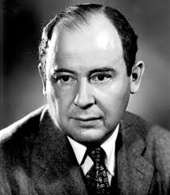
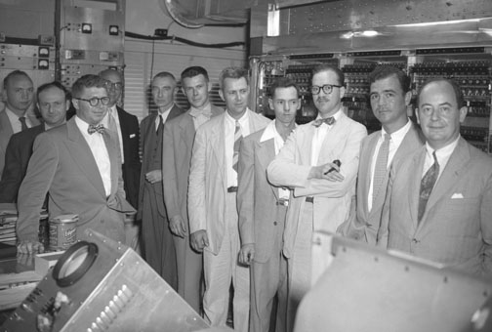
Computing Platforms
Von Neumann Model
In 1950s, Dr. John von Neumann wrote
The Computer and the Brains that
described a system architecture for the
modern micro-processor computing
machine.
Reference:
http://en.wikipedia.org/wiki/Von_Neumann_architecture
Daybreak of the Digital Age (http://paw.princeton.edu/issues/2012/04/04/pages/5444/index.xml?page=3&)

Slide 6
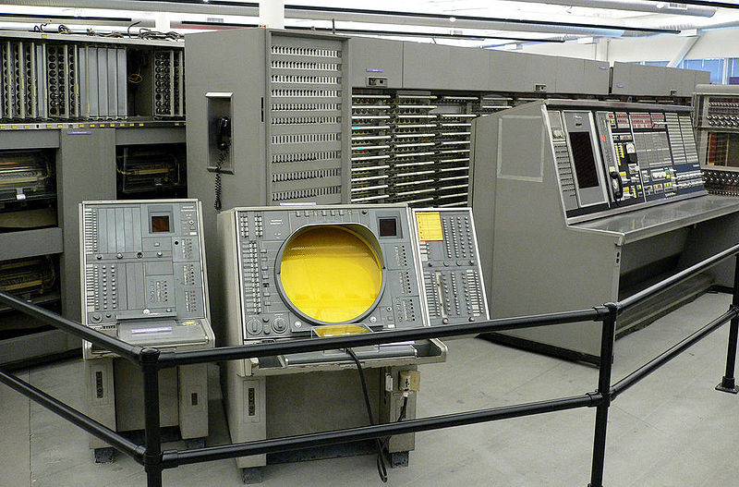
Computing Platforms
MITRE’s SAGE System
Semi-Automatic Ground Environment (SAGE)
Reference: http://en.wikipedia.org/wiki/Semi-Automatic_Ground_Environment

Slide 7
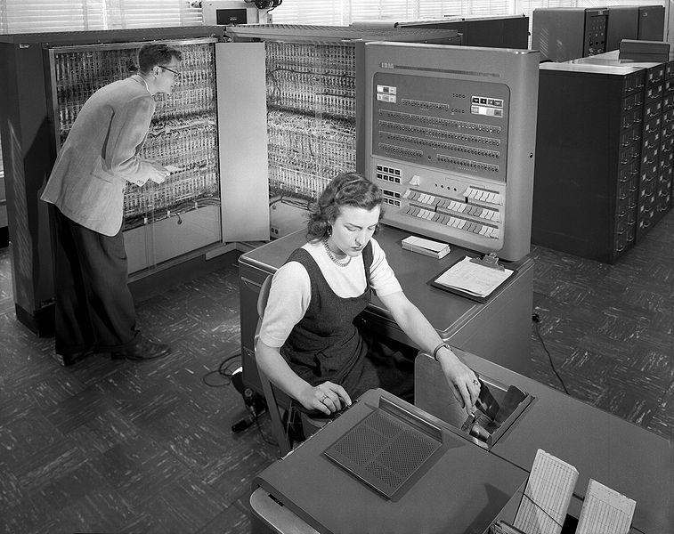
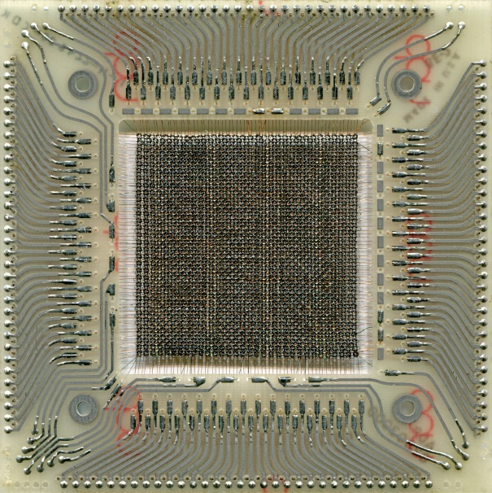
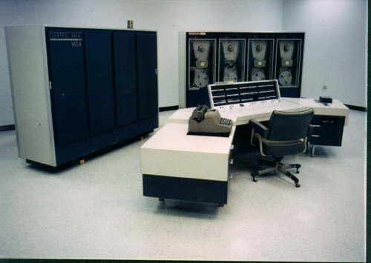
Computing Platforms
Transistorized Computers – IBM 7000 Series, CDC 1604

Slide 8
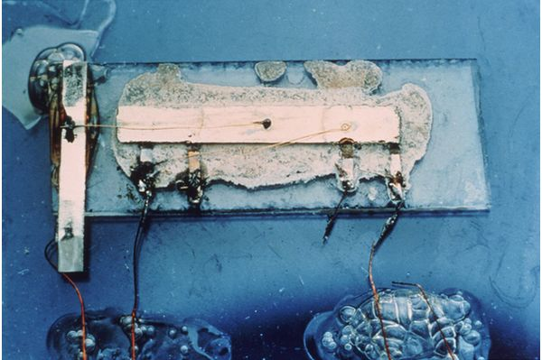
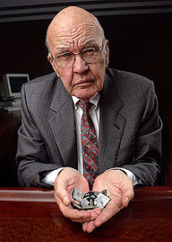
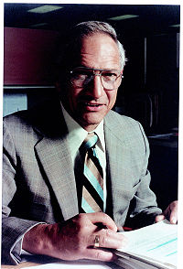
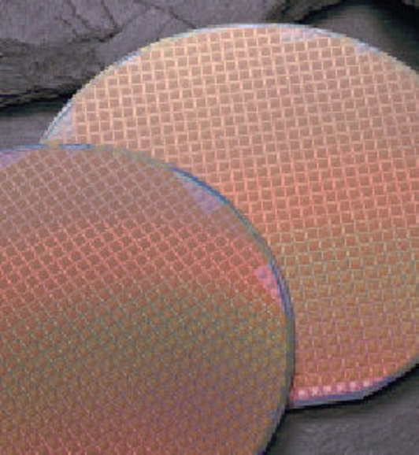
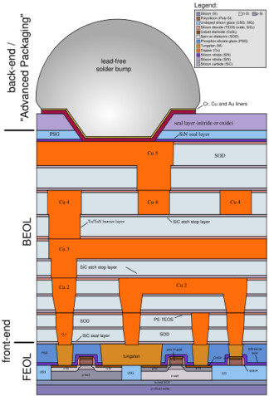
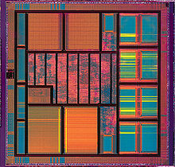
Computing Platforms
Integrated Circuit (IC) / Micro-processor
In late 1950s, the integrated circuit (IC) invented by:
  Jack Kilby of Texas Instruments, and
  Robert Noyce of Fairchild Semiconductor
Electro-mechanical computing machines → Micro-processor computing machines
Reference: Google image search.

Slide 9
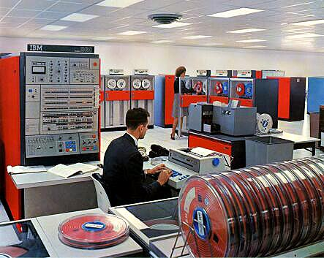
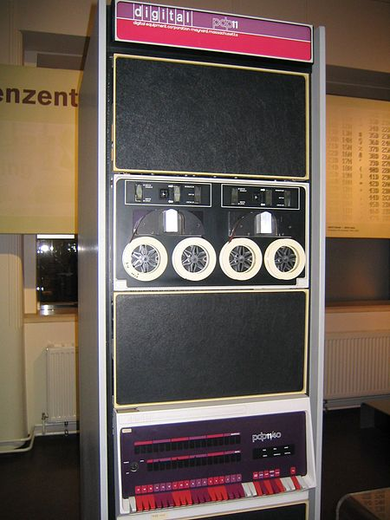
Computing Platforms
Integrated Circuit (IC)/Large Scale Integration (LSI) Computers – IBM System/360 and PDP-11
Reference:
IBM Archives: System/360 Model 50 (http://www-03.ibm.com/ibm/history/exhibits/mainframe/mainframe_PP2050.html)
PDP-11 (http://en.wikipedia.org/wiki/PDP-11)

Slide 10
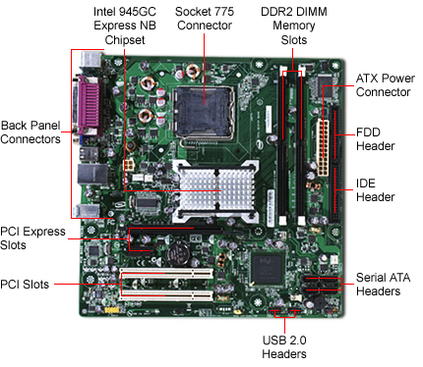
Computing Platforms
Hardware Components
Central Processing Unit (CPU)
  Registers (General-purpose, Dedicated)
  Arithmetic Logical Unit (ALU)
Memory
  Primary + Secondary Cache
  Read Only Memory (ROM)
  Random Access Memory (RAM)
  Flash Memory
  Virtual Memory (via Storage)
Input/Output (I/O) Devices
  System Bus & Channels
  Serial, Parallel, USB, SCSI, PCMCIA, etc.
  Network Interface Card (NIC)
Storage
  Disk, Tape, Flash (USB Jump Drive + PCMCIA)

Slide 11
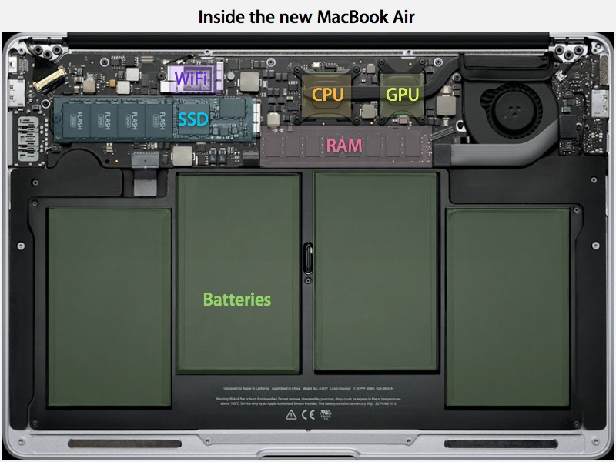
Computing Platforms
Hardware Components
Source:
AppleInsider (http://appleinsider.com/articles/10/10/30/review_apples_new_11_6_inch_and_13_3_inch_macbook_air_late_2010/page/3)

Slide 12
Computing Platforms
Software Components
Operating System (OS)
Firmware (stored in ROM/EPROM/EEPROM)
  BIOS
  Device Firmware
Input/Output (I/O) Controllers
  Device Drivers
System Programs & Applications
  File Management Systems
  Network Management
  Process Management
Mobile Code
  Java Virtual Machine (JVM)
  Active X
  Application Macro
Data / Memory Addressing
  Register, Direct, Absolute, Indexed, Implied.
  Memory Protection

Slide 13
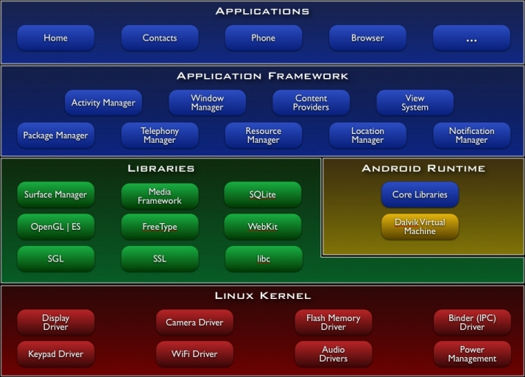
Computing Platforms
Software Components
Source:
Android Architecture (http://elinux.org/Android_Architecture)

Slide 14
Computing Platforms
Operating System (OS)
User identification and authentication.
Discretionary access control (DAC).
Mandatory access control (MAC).
Mediate transactions.
Object reuse protection.
  Prevent leakage.
Accountability.
  Audit security events.
  Protection of audit logs.
Trusted path.
  Protection of critical operations.
Intrusion detection.
  Patterns, analysis, and recognition.

Slide 15
Computing Platforms
OS Process Scheduling
Multi-programming
  Managing and coordinating the process operations to multiple sets of programmed instructions e.g. VMS (Mainframe)
Multi-tasking
  Allows user to run multiple programs (tasks) e.g. Windows 2000, LINUX
Multi-threading
  Managing the process operations by work/execution threads (a series of tasks) using the same programmed instructions. Which allows multiple users and service requests e.g. Mach Kernel (BSD UNIX: Solaris, MacOS X, etc.)
Multi-processing
  Managing and coordinating the process operations to multiple sets of programmed instructions and multiple user requests using multiple CPUs e.g. Windows 2000, LINUX, UNIX

Slide 16
Computing Platforms
CPU Processing Threads
Most of today’s programs are comprised of many individual modules, programs or processes that are separately written and work together to fulfill the overall objective of the application
These may be called modules or processing threads
The security problems lie in the fact that these independent sections may be written by someone else then they may link dynamically and not be controlled by the Operating System (OS)

Slide 17
Computing Platforms
Operating Modes and Processing States
Modes of operation
  Kernel mode (privileged)
    Program can access entire system
    Both privileged and non-privileged instructions
  User mode (non-privileged)
    Only non-privileged instruction executed
    Intended for application programs
Processing states
  Stopped vs. Run state
  Wait vs. Sleep state
  Masked/interruptible state
    E.g. if masked bit not set, interrupts are disabled (masked off) – known as IRQs in systems.

Slide 18
Computing Platforms
Memory Management – Functional Requirements
There are five functional requirements for memory management:
  Physical Organization (Physical)
    Provide management of data in physical memory space (e.g., CPU registers, cache, main memory (RAM), disk storage (secondary storage))
  Logical Organization (Logical)
    Provide management of data in logical segments (virtual memory)
  Relocation (Relative)
    Provide pointers to the actual location in memory
  Protection
    Provide access control to protect integrity of memory segments
  Sharing
    Allowing access to memory segment

Slide 19
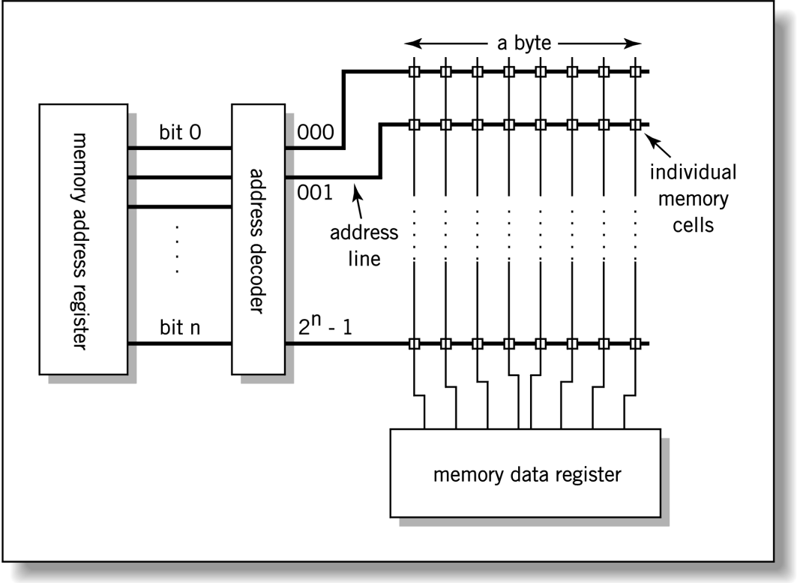
Computing Platforms
Memory Management – Type of memory addressing
Three types of memory addresses:
  Physical – the absolute address or actual location
  Logical – reference to a memory location that is independent of the current assignment of data to memory. (Requires a translation to the physical address.)
  Relative – address expressed as a location relative to a known point
Notes:
Page 305

Slide 20
Computing Platforms
Memory Management – Storage
Types of memory:
  Real (A program or application defined storage location in memory and direct access to peripheral devices e.g. Comm. buffer)
  Virtual (Extended primary memory to secondary storage medium)
Types of storage:
  Primary (Memory direct accessible to CPU e.g. Cache and RAM)
  Secondary (Non-volatile storage medium e.g. Disk Drives)
Notes:
With advent multi-CPU configuration, Level-3 (L3) cache is created for sharing between CPUs.

Slide 21
Computing Platforms
Memory Management – Paging & Swapping
Virtual Memory is a memory management technique that extends memory by using secondary storage for program pages not being executed.
Paging involves:
  Splitting memory into equal sized small chunks that are called page frames.
  Splitting programs (processes) into equal sized small chunks are called pages.
  OS maintains a list of free frames
  Pages are fixed blocks of memory usually 4K or 8K bytes
  A page-fault is when a program accesses a page that is not mapped in physical memory.
Swapping is the act of transferring pages between physical memory and the swap space on a disk.

Slide 22
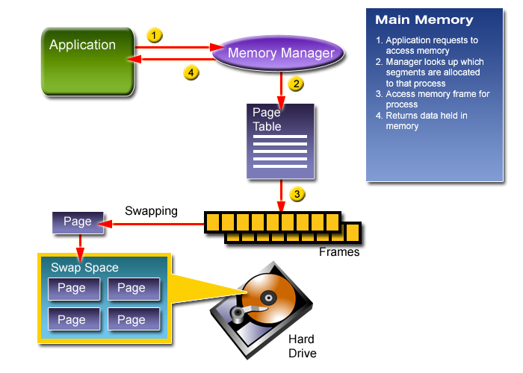
Computing Platforms
Memory Management: Paging & Swapping
Reference: ISSA-Alamo CISSP Training Course.

Slide 23
Computing Platforms
Input/Output Devices
The I/O controller is responsible for moving data in and out of memory.
An element of managing the I/O devices and thus managing memory is through swapping or paging files.

Slide 24
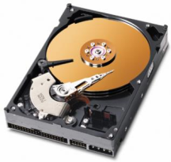

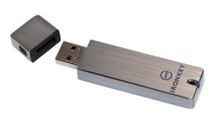
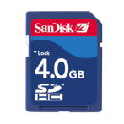

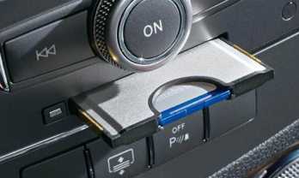
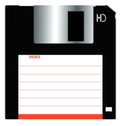
Computing Platforms
Input/Output Devices – Storage
Storage devices for secondary memory:
  Hard disk drives
  Write-Once Read Memory (WORM) (Storage medium such as CD-ROM, DVD-ROM)
  USB flash drives
  SD, Micro-SD memory cards
  PCMCIA memory cards
  Floppy disk drives

Slide 25
Topics
Security Architecture & Models Domain
Computing Platforms
Security Models
  Information Security Models
Evaluation & Certification
Security Architecture
  Modes of Operation
  Architecture Concepts
  Implementation Models

Slide 26
Security Models
Information Security Models
Security model specifies the operational and functional behavior of a “system” for security.
There are many security models:
  Graham-Denning Model – formal system of protection rules.
  Information-Flow Model – demonstrates the data flows, communications channels, and security controls.
  State-Machine Model – abstract math model where state variable represent the system state. The transition functions define system moves between states.
  Non-Interference Model – a subset of information-flow model that prevents subjects operating in one domain from affecting each other in violation of security policy. (i.e. Compartmentalized.)
Others are combination of above and generalized access control models.
Notes:
Next – Security Models. There are 4 fundamental types of security models:
Graham-Denning Model. First published in 1972, it is a set of formally described system of protection rules.
State-Machine Model. This is the computer security policy model that has been mathematically proved, and carried out by the computer operating systems or applications.
3. Information-Flow Model. This is a matrix that illustrates the communications channels and the data flow directions.
Non-Interference Model. This is what we usually called “compartmentalized” security.
Note: For the exam, you just need to know what they are, because all security models are based on at least one of those security models.

Slide 27
Security Models
Terms and Definition … (1/2)
A subject requests service
  A subject can be user, program, process, device, etc.
An object provides the requested service
  An object can be file, database, program, process, devices, etc.
A security model specifies the rules of behavior for a “system” (/ system of systems) in meeting the security objectives, where:
  Security objective: confidentiality, integrity
  Implementation rules: least-privilege, separation-of-duties

Slide 28
Security Models
Terms and Definition … (2/2)
Access is the flow of information between a subject and an object(s).
Access capability is what a subject can do to an object(s).
Access control governs the information flow.
  Discretionary access control (DAC) is where the information owner determines the access capabilities of a subject to what object(s).
  Mandatory access control (MAC) is where the access capabilities are pre-determined by the security classification of a subject and the sensitivity of an object(s).

Slide 29
Information Security Models
Graham-Denning Security Model
Graham-Denning is an information access model operates on a set of subjects, objects, rights.
Levels of Protection
  No sharing at all
  Sharing copies of programs/ data files
  Sharing originals of programs/ data files
  Sharing programming systems/ subsystems
  Permitting the cooperation of mutually suspicious subsystems, e.g., debugging/ proprietary subsystems
  Providing memory-less subsystems
  Providing “certified” subsystems
Operations
  How to securely create an object/subject.
  How to securely delete an object/subject.
  How to securely provide the read access right.
  How to securely provide the grant access right.
  How to securely provide the delete access right.
  How to securely provide the transfer access right.
References: G.S.Graham and P.J. Denning, Protection – Principles and Practice, AFIPS Conf. Proc., 1972.
Notes:
For all of you, this should be just an review of your CISSP – Security Architecture & Model domain…
Graham-Denning security model is one of the first formally explained security model for information system. It is an information access model that operates based on a set of rights between a set of subjects and objects. It is usually explained as an access control matrix.
<Click, Next slide>

Slide 30
Information Security Models
Harrison-Ruzzo-Ullman (HRU) Security Model
Access capability matrix specifying types of access
  Subject-object
  One row per subject. One column per object
  It is a version of Graham-Denning
 |  | Objects
 |  | S₁ | S₂ | S₃ | S₄ | S₅ | O₁ | O₂ | O₃ | O₄ | O₅
 | S₁ | Cntrl | --- | --- |  |  | rwx | rw- | --- | --- | ---
 | S₂ | --- | Cntrl | --- |  |  | --- | --- | --x | --- | ---
 | S₃ | --- | --- | Cntrl | r-x |  | --- | --- | --- | --- | ---
 | S₄ | --- | --- | --- | Cntrl |  | --- | r-x | --- | --- | r-x
 | S₅ | --- | --- | --- |  | Cntrl | --- | r-x | --- | --- | ---
Subjects
References: M. Harrison, W. Ruzzo, and J.D. Ullman, Protection in Operating Systems, Communications of the ACM, August 1976
Notes:
RHU Access Control Matrix is the most commonly used version of Graham-Denning security model. Developed in 1976 by Michael Harrison, Walter Ruzzo, and Jeffrey Ullman (HRU). It is usually used in conjunction with other security policy models… Why? Because it does not describe state-transitions!
For example, the router access control list. It is an implementation of subject: Protocols/Port Number, to object: Network Interface. The IOS is the program in Clark-Wilson state-machine that determines the ports and protocols and logically control by the programmed ACLs.

Slide 31
Information Security Models
Information Flow Model
Information flow model illustrates the direction of data flow between objects
  Based on object security levels
  Information flow is constrained in accordance with object’s security attributes
  Covert channel analysis is simplified
Note: Covert channel is moving of information to and from unauthorized transport
 | A | B | C | D
A | N/A |  | X | X
B |  | N/A | X
C | X |  | N/A | X
D |  |  |  | N/A

Slide 32
Information Security Models
Bell-LaPadula Security Model …(1/3)
Bell-LaPadula is a state-machine model for information flow and access control.
Confidentiality only!
Secure state-access is only permitted in accordance with specific security policy
Secure state is when rules are security-preserving
Fundamental modes of access:
  Read only, Write only, or Read & Write.
Discretionary Security: Specific subject authorized for particular capability of access.
Reference: D. Bell, L. LaPadula , MTR-2997, Secure Computer System: Unified Exposition and Multics Interpretation, March 1976.

Slide 33
Information Security Models
Bell-LaPadula Security Model …(2/3)
Bell-LaPadula confidentiality policy:
  Simple security property
    Subject cannot read object of higher sensitivity.
  Star property (* property)
    Subject cannot write to object of lower sensitivity.
  Strong Star property (Strong * property)
    Subject cannot read/write to object of higher/lower sensitivity.

Slide 34
Information Security Models
Bell-LaPadula Security Model …(3/3)
Bell-LaPadula security model has two major limitations:
Confidentiality only
No method for management of classifications
  It assumes all data are assigned with a classification
  It assumes the data classification will never change
Hence the need for…
  E.O. 13526 (updates E.O. 13292, E.O. 12958), Classified National Security Information, Dec. 29, 2009
  E.O. 13467(updates E.O. 12968), Reforming Process Related to Suitability for Government Employment, Fitness for Contractor Employees, and Eligibility for Access to Classified Information, July 2, 2008
  DoD 5200.01-M, Information Security Program, Vol. 1-4, March 2012
Reference: Secrets & Lies – Digital Security in a Networked World, Bruce Schneier, 2004

Slide 35
Information Security Models
Biba Security Model …(1/2)
Biba Security Model is a state-machine model for information flow and integrity control
Addresses integrity in information systems.
Based on hierarchical lattice of integrity levels
Elements
  Set of subjects (Active, information processing)
  Set of objects (Passive, information repository)
Integrity: Prevent unauthorized subjects from modifying objects.
Mathematical dual of access control policy
  Access Tuple: subject & object.
Reference: K. Biba, MTR-3153, Integrity Consideration for Secure Computing System, 1975

Slide 36
Information Security Models
Biba Security Model …(2/2)
Biba security policy:
  Simple integrity condition
    Subject cannot read objects of lesser integrity.
  Integrity star * property
    Subject cannot write to objects of higher integrity.
  Invocation property
    Subject cannot send messages (logical request for service) to object of higher integrity.

Slide 37
Information Security Models
Clark-Wilson Security Model …(1/3)
Clark-Wilson is a state-machine security model addresses information flow and the integrity goals of:
  Preventing unauthorized subjects from modifying objects
  Preventing authorized subjects from making improper modification of objects
  Maintaining internal and external consistency
Well-formed transaction
  Preserve/ensure internal consistency
  Subject can manipulate objects (i.e. data) only in ways that ensure internal consistency.
Access Triple: Subject-Program-Object
  Subject-to-Program and Program-to-Object.
  Separation-of-Duties
Reference: D. Clark, D. Wilson, A Comparison of Commercial and Military Computer Security Policies, IEEE Symposium on Security and Privacy, 1987

Slide 38
Information Security Models
Clark-Wilson Security Model …(2/3)
Certification rules:
  C1: When an integrity verification procedure (IVP) is run, it must ensure that all constrained data items (CDIs) are in a valid state.
  C2: For some associated set of CDIs, a transformation procedure (TP) must transform those CDIs in a valid stat into a (possibly different) valid state.
  C3: The allowed relations must meet the requirements imposed by separation-of-duties principle.
  C4: All TP must append sufficient information to reconstruct the operation to an append-only CDI.
  C5: Any TP that takes a un-constrained data item (UDI) as input may perform only valid transformations, or none at all, for all possible values of the UDI. The transformation either rejects the UDI or transforms it into a CDI.
Enforcement rules:
  E1: The system must maintain the certified relations, and must ensure that only transformation processes (TPs) certified to run on a constrained data item (CDI) manipulate that CDI.
  E2: The system must associate a user with each TP and set of CDIs. The TP may access those CDIs on behalf of the associated user.
  E3: The system must authenticate each user attempting to execute a TP.
  E4: Only the certifier of a TP may change the list of entities associated with a TP. No certifier of a TP, or of an entity associated with that TP, may ever have execute permission with respect to that entity.
Reference: D. Clark, D. Wilson, A Comparison of Commercial and Military Computer Security Policies, IEEE Symposium on Security and Privacy, 1987
Notes:
IVP = Integrity verification procedure
CDI = Constrained data item
UDI = Unconstrained data item
TP = Transformation process

Slide 39
Information Security Models
Clark-Wilson Security Model …(3/3)
Clark-Wilson security model is often implemented in modern database management systems (DBMS) such as: Oracle, DB2, MS SQL, and MySQL.
Reference: Secure Database Development and the Clark-Wilson Security Model, X.Ge, F.Polack, R.Laleau, University of York, UK.

Slide 40
Information Security Models
Brewer-Nash Security Model (a.k.a. Chinese Wall)
Brewer-Nash security model is an information flow model used to implement dynamically changing access permissions.
A “wall” is defined by a set of rules that ensures no subject from one side of the wall can access objects on the other side of the wall.
Reference: The Chinese Wall Security Policy, D.F.C. Brewer, M. Nash, Gama Secure Systems, UK.

Slide 41
Information Security Models
Non-interference Model …(1/2)
Non-interference model (a.k.a. Goguen-Meseguer security model) is loosely based on the information flow model; however, it focuses on:
How the actions of a subject at a higher
sensitivity level affect the system state or
actions of a subject at a lower sensitivity
level. (i.e., interference)
  Users (subjects) are in their own compart-
  ments so information does not flow or
  contaminate other compartments
  With assertion of non-interference security policy, the non-interference model can express multi-level security (MLS), capability passing, confinement, compartmentation, discretionary access, multi-user/multi key access, automatic distribution and authorization chains, and downgrading.
Reference: Security Policies and Security Models, J.A. Goguen, J. Meseguer, IEEE, 1982.

Slide 42
Information Security Models
Non-interference Model …(2/2)
Information flow is controlled by the security policy, where security policy is a set of non-interference assertions (i.e., “capabilities”.) For example:
  A, B, C, and D are compartmentalized subjects.
  A1, A2, and A3 are non-interference assertions that defines the “capabilities” of what subjects can do.
Non-interference is to address covert channels and inference attacks.
Note: Bell-LaPadula (BLP) is about information flow between objects.
Reference: Security Policies and Security Models, J.A. Goguen, J. Meseguer, IEEE, 1982.

Slide 43
Information Security Models
Rule-set Based Access Control Model
Access is based on a set of rules that determines capabilities.
The model consists of:
  Access enforcement function (AEF)
  Access decision function (ADF)
  Access control rules (ACR)
  Access control information (ACI)
Reference: M.D. Abrams, K.W. Eggers, L.J. LaPadula, I.M. Olson, Generalized Framework for Access Control: An Informal Description, October, 1990.

Slide 44
Information Security Models
Example of Rule-set Based Access Control: Role-based Access Control (RBAC)
Limited hierarchical RBAC-based authorization for web services.
  User Assignment: Identity-to-roles.
  Permission Assignment: Roles-to-privileges.
Reference: Role Based Access Control (RBAC) and Role Based Security, NIST. (http://csrc.nist.gov/groups/SNS/rbac/)
Notes:
Next, this is an conceptual example of Role-based Access Control (RBAC). This information operations shows that the user assignments between the user and user roles are “many-to-many”. The user functional roles are hierarchical and they are subjected to a set of permission assignments that restricts computing operations to data objects.
As you can see… the description of information operations varies on the need. They are contextual and conceptual. As a security architect/engineer, one must be able to describe them, so the programmer or system engineers or product vendors can understand what you are looking for.

Slide 45
Topics
Security Architecture & Models Domain
Computing Platforms
Security Models
  Information Security Models
Evaluation & Certification
Security Architecture
  Modes of Operation
  Architecture Concepts
  Implementation Models

Slide 46
Evaluation Criteria
Trusted Computer System Evaluation Criteria (TCSEC)
  Evaluates Confidentiality
Information Technology Security Evaluation Criteria (ITSEC)
  Evaluates Confidentiality, Integrity and Availability
Common Criteria (CC)
  Provided a common structure and language
  It’s an International standard (ISO 15408)

Slide 47
Evaluation Criteria
Trusted Computer Security Evaluation Criteria
(TCSEC) (DoD 5200.28-STD)
Based on meeting the following 6 requirements…
Security policy – DAC or MAC.
Marking of objects – Sensitivity labels.
Identification of subjects – Identification & authorization of users (subjects).
Accountability – Audit logs
Assurance – Operational security requirements.
  Assurance in meeting the policy, marking, identification, and accountability requirements
  Documentation – Security features user’s guide (SFUG), trusted facility manual (TFM), test & design document
Continuous protection – Anti-tamper provision.
Reference: DoD 5200.28-STD, Trusted Computer System Evaluation Criteria (TCSEC), December 26, 1985.

Slide 48
Evaluation Criteria
TCSEC Divisions
Division D: Minimal Protection
Division C: Discretionary Protection (DAC)
  C1: Discretionary Security Protection
  C2: Controlled Access Protection
Division B: Mandatory Protection (MAC)
  B1: Labeled Security Protection
  B2: Structured Protection
  B3: Security Domains
Division A: Verified Protection
  A1: Verified Design
Reference: DoD 5200.28-STD, Trusted Computer System Evaluation Criteria (TCSEC), December 26, 1985.

Slide 49
Evaluation Criteria
TCSEC Division C: Discretionary Protection
C1: Discretionary Security Protection.
  Security policy: discretionary access control
  Accountability: identification and authentication
  Assurance:
    Operational assurance: system architecture, system integrity
    Life-cycle assurance: security testing
  Documentation: security features user’s guide (SFUG), trusted facility manual (TFM), test document, design document
C2: Controlled Access Protection.
  C1 +
  Security policy: object reuse
  Accountability: audit
Reference: DoD 5200.28-STD, Trusted Computer System Evaluation Criteria (TCSEC), December 26, 1985.

Slide 50
Evaluation Criteria
TCSEC Division B: Mandatory Protection
B1: Labeled Security Protection
  Security policy: DAC, object reuse, labels, MAC
  Accountability: identification and authentication, audit
  Assurance:
    Operational assurance: system architecture, system integrity
    Life-cycle assurance: security testing, design specification and verification
  Documentation: security feature user’s guide (SFUG), trusted facility manual (TFM), test and design documentation
Reference: DoD 5200.28-STD, Trusted Computer System Evaluation Criteria (TCSEC), December 26, 1985.

Slide 51
Evaluation Criteria
TCSEC Division B: Mandatory Protection
B2: Structured Protection
  Security policy: B1 + subject sensitivity labels, device labels
  Accountability: B1 + trusted path
  Assurance:
    Operational assurance: B1 + covert channel analysis, trusted facility management
    Life-cycle assurance: B1 + configuration management
  Documentation: B1
B3: Security Domains
  Security policy: B2
  Accountability: B2
  Assurance:
    Operational assurance: B2 + trusted recovery
    Life-cycle assurance: B2
  Documentation: B2
Reference: DoD 5200.28-STD, Trusted Computer System Evaluation Criteria (TCSEC), December 26, 1985.

Slide 52
Evaluation Criteria
TCSEC Division A: Verified Protection
A1: Verified Design
  Functionally equivalent as class: B3
  Requires design verification
    Security policy must be identified and documented (including a mathematical proof of the security model)
    Must provide a formal top-level specification (FTLS) that identifies all the components that constitutes trusted computing base (TCB)
    The FTLS of the TCB must be shown to be consistent with the documented security policy model (FTLS ≈ security policy)
    The TCB must be shown to be consistent with the documented FTLS (TCB ≈ FTLS)
    Formal analysis techniques must be used to identify and analyze covert channels
Reference: DoD 5200.28-STD, Trusted Computer System Evaluation Criteria (TCSEC), December 26, 1985.

Slide 53
Evaluation Criteria
Information Technology Security Evaluation
Criteria (ITSEC)
Security objectives: Why is the functionality wanted?
  Statements about the system environment.
  Assumption about the target of evaluation (TOE) environment.
Security functions (F): What is actually done?
  Rational for security functions.
  Required security mechanisms.
  Required evaluation level.
Security assurance (E): How is it done?
  The level of assurance required in the TOE.
Reference: Information Technology Security Evaluation Criteria (ITSEC), version 1.2, June 28, 1991.

Slide 54
Evaluation Criteria
ITSEC – Functional + Assurance Ratings
Functional (F)
  F-C1 – F-B3 Mirror the functionality aspects of TCSEC (Orange Book) classes.
  F6 High integrity req. for data and programs.
  F7 High availability req. for system.
  F8 High integrity req. for data communications.
  F9 High confidentiality req. for data communications.
  F10 High confidentiality + integrity req. for data communications.
Assurance (E)
  E0 Inadequate assurance.
  E1 System in development.
  E2 Informal system tests.
  E3 Informal system + unit tests.
  E4 Semi-formal system + unit tests.
  E5 Semi-formal system + unit tests and source code review.
  E6 Formal end-to-end security tests + source code reviews.
Reference: Information Technology Security Evaluation Criteria (ITSEC), version 1.2, June 28, 1991.

Slide 55
Evaluation Criteria
ITSEC vs. TCSEC
ITSEC Rating | TCSEC Rating
E0 | D - Minimal Security
F-C1, E1 | C1 - Discretionary Security Protection
F-C2, E2 | C2 - Controlled Access Protection
F-B1, E3 | B1 - Labeled Security
F-B2, E4 | B2 - Structured Protection
F-B3, E5 | B3 - Security Domains
F-B3, E6 | A1 - Verified Design
F6 - High integrity | N/A
F7 - High availability | N/A
F8 - Data integrity during communications | N/A
F9 - High confidentiality (encryption) | N/A
F10 - Networks w/high demands on confidentiality and integrity | N/A
Reference: Information Technology Security Evaluation Criteria (ITSEC), version 1.2, June 28, 1991.

Slide 56
Evaluation Criteria
Common Criteria (ISO 15408)
Protection Profile (PP)
  Specific functional and assurance requirements
  Applies to a category of products, not just a single one
Target of Evaluation (TOE)
  The specific product or system that is being evaluated
Security Target (ST)
  Written by vendor or developer to explain functional and assurance specifications of product, and how they meet CC or PP requirements
Evaluation Assurance Level (EAL)
  Combined rating of functional and assurance evaluation
Reference: Common Criteria Evaluation & Validation Scheme (CCEVS), Version 2.3, August 2005.

Slide 57
Evaluation Criteria
Common Criteria (ISO 15408)
Part One: Introduction and General Model.
Part Two: Security Functional Requirements.
Part Three: Security Assurance Requirements (establishes a set of assurance components – Evaluation Assurance Levels (EAL)).
Reference: Common Criteria Evaluation & Validation Scheme (CCEVS), Version 2.3, August 2005.

Slide 58
Evaluation Criteria
Common Criteria Security Requirements
Assurance Requirements define the security attributes (or countermeasures) that in information system shall provide so the system owner can have a measurable level of assurance that the risks have been sufficiently addressed (or mitigated.)
Functional Requirements explain the operational functions which an information system shall perform in support of subjects access the objects.

Slide 59
Evaluation Criteria
Common Criteria – Protection Profile (PP)
Protection Profile (PP) is an implementation-independent specification of information security requirements.
  Security objectives
  Security functional requirements
  Information assurance requirements
  Assumption and rationale
Reference: Common Criteria Evaluation & Validation Scheme (CCEVS), Version 2.3, August 2005.

Slide 60
Evaluation Criteria
Common Criteria – Security Target (ST) & Target of Evaluation (TOE)
Security Target (ST) is similar to PP. It is a vendor response to PP that contains implementation-specific information to demonstrate how the Target of Evaluation (TOE) addresses PP.
Target of Evaluation (TOE) is the specific product or system that is being evaluated.
Reference: Common Criteria Evaluation & Validation Scheme (CCEVS), Version 2.3, August 2005.
Notes:
The sponsor is responsible for providing the security target (ST) and the associated IT product that will become the target of evaluation (TOE). The sponsor must ensure that all essential documentation to be provided to the CCTL is available. The sponsor then contacts a CCTL to negotiate a contract and initiate the security evaluation.

Slide 61
National Information Assurance Partnership (NIAP) and Common Criteria (CC)
Common Criteria (CC) (ISO 15408)
Evaluation Assurance Level (EAL) is the combined rating of functional and assurance evaluation
  EAL 1: Functionally tested
  EAL 2: Structurally tested
  EAL 3: Methodically tested and checked
  EAL 4: Methodically designed, tested, and reviewed
  EAL 5: Semi formally designed and tested
  EAL 6: Semi formally verified, designed, and tested
  EAL 7: Formally verified, designed, and tested
  The U.S. recognizes products that have been evaluated under the sponsorship of other signatories and in accordance with the International Common Criteria for Information Technology Security Evaluation Recognition Arrangement (CCRA) for EALs 1-4 only.
Reference: Common Criteria Evaluation & Validation Scheme (CCEVS), Version 2.3, August 2005.
Notes:
EAL – Evaluation Assurance Level is the combined rating of functional and assurance evaluation of the TOE.
EAL 1 means the TOE is functionally tested.
EAL 2 means the TOE is structurally tested.
EAL 3 is methodically tested and checked
EAL 4 is methodically designed, tested, and reviewed.
EAL 5 is semi formally designed and tested
EAL 6 is semi formally verified, designed and tested.
EAL 7 is the highest EAL level, a TOE is formally verified, designed and tested.

Slide 62
Topics
Security Architecture & Models Domain
Computing Platforms
Security Models
  Information Security Models
Evaluation & Certification
Security Architecture
  Modes of Operation
  Architecture Concepts
  Implementation Models

Slide 63
Modes of Operation… (1/2)
Dedicated
  System is specifically & exclusively dedicated to and controlled for the processing of one type or classification of information.
System-high
  Entire system is operated at the highest security classification level, and trusted to provide “need-to-know” to a specific user or role (DAC)
Multi-Level Security (MLS)
  A system which allows to operate and process information at multiple classification levels.
  Controlled mode.
    The mode of operation that is a type of MLS in which a more limited amount of trust is placed in the HW/SW base of the system, with resultant restrictions on the classification levels and clearance level that can be supported.
Compartmentalized
  A system which allows to operate and process information at multiple compartmented information. Not all user have the “need-to-know” on all information.

Slide 64
Modes of Operation… (2/2)
Mode | Clearance Level | Access Approval | Need-to-Know
Dedicated | Proper clearance for all information on the system | Formal access approval for all information on the system | A valid need-to-know for all information on the system
System-High | Proper clearance for all information on the system | Formal access approval for all information on the system | A valid need-to-know for some of the information on the system
Compartmental | Proper clearance for the highest level of data classification on the system | Formal access approval for all information they will access on the system | A valid need-to-know for some of the information on the system
MLS | Proper clearance for all information they will access on the system | Formal access approval for all information they will access on the system | A valid need-to-know for some of the information on the system
Reference: DCID 6/3 Protecting Sensitive Compartmented Information Within Information Systems, 2000.

Slide 65
Security Architecture
Reference Monitor
A reference monitor is an abstract machine that mediates all accesses to objects by subjects
Reference monitor is performed by a reference validation mechanism where it is a system composed of hardware, firmware, and software
Reference: DoD 5200.28-STD, Trusted Computer System Evaluation Criteria (TCSEC), December 26, 1985.

Slide 66
Security Architecture
Reference Monitor
Design requirements:
  The reference validation mechanism must always be invoked.
  The reference validation mechanism must be tamper proof.
  The reference validation mechanism must be small enough to be subject to analysis and tests to assure that it is correct.
Reference monitor is “policy neutral”.
  TCSEC requires Bell-LaPadula
  But, can be implemented for database security, network security, and other applications, etc.
Reference:
DoD 5200.28-STD, Trusted Computer System Evaluation Criteria (TCSEC), December 26, 1985.
The Reference Monitor Concept as a Unifying Principle in Computer Security Education, C.E. Irvine, Naval Postgraduate School 1999

Slide 67
Security Architecture
Trusted Computing Base (TCB)
The Trusted Computing Base is the totality of protection mechanisms within a computing system – hardware, firmware, software, processes, transports
The TCB maintains the confidentiality and integrity of each domain and monitors four basic functions:
  Process activation
  Execution domain switching
  Memory protection
  Input/Output operation
Reference: DoD 5200.28-STD, Trusted Computer System Evaluation Criteria (TCSEC), December 26, 1985.

Slide 68
Security Architecture
TCB – Rings of Protection
Ring number determines the access level.
A program may access only data that resides on the same ring, or a less privileged ring.
A program may call services residing on the same, or a more privileged ring.
Ring 0 contains kernel functions of the OS.
Ring 1 contains the OS.
Ring 2 contains the OS utilities.
Ring 3 contains the applications.
Notes:
OS Security Kernel is at the center – highest privilege and most protected.
Reference Monitor is component of security kernel that enforces access control on objects.
Uses least privilege principle – processes have only the privileges they need to operate.
Only privileged instructions and programs are allowed to cross ring boundaries.

Slide 69
Questions:
Which information security model is for confidentiality only?
Which information security model utilizes access triple (i.e. subject-program-object) to enforce “well-formed” transactions?
Which information security model allows dynamic change of access permission?
Which information security model defines the direction of the information flow?

Slide 70
Answers:
Which information security model is for confidentiality only?
  Bell-LaPadula
Which information security model utilizes access triple (i.e. subject-program-object) to enforce “well-formed” transactions?
  Clark-Wilson
Which information security model allows dynamic change of access permission?
  Brewer-Nash
Which information security model defines the direction of the information flow?
  Information Flow Model

Slide 71
Questions:
What mediates all accesses to objects by subjects?
What is the protection mechanism inside a computer that is responsible for enforcing the security policy?
What is the system (e.g., hardware, firmware, OS, and software applications) that implements the reference monitor concept?

Slide 72
Answers:
What mediates all accesses to objects by subjects?
  Reference monitor validation mechanism
What is the protection mechanism inside a computer that is responsible for enforcing the security policy?
  Secure kernel (i.e., rings of protection)
What is the system (e.g., hardware, firmware, OS, and software applications) that implements the reference monitor concept?
  Trusted computing base (TCB)

Slide 73
Topics
Security Architecture & Models Domain
Computing Platforms
Security Models
  Information Security Models
Evaluation & Certification
Security Architecture
  Modes of Operation
  Architecture Concepts
  Implementation Models

Slide 74
Information Security Concepts
Security Architecture & Construction Methodology
Security Architecture is an integrated view of System Architecture from a security perspective.
Security Architecture describes how the system should be implemented to meet the security requirements.
  Operational View = A set of Enterprise Mission/Business Operational Processes that influences the selection of Security Operational, Management and Technical Controls
  Systems View = The Enterprise-wide System of Systems that influences the selection of Security Management, Technical, Operational Controls
  Technical Standards View = The implemented technologies that influence the selection of Security Technical, Operational and Management Controls
References:
DoD Architecture Framework (DoD AF) V1.0
FIPS 200, Minimum Security Controls for Federal Information Systems

Slide 75
Implementation Architecture
Security Architecture
Enterprise – A collective of functional organizations / units that is composed of multiple domain and networks.
Architecture – The highest level concept of a system in its operating environment (Conceptual model)
Security Architecture – A integrated view of system architecture from a security perspective
Enterprise Security Architecture – An integrated view of enterprise system architecture from a perspective of meeting the organizational security policy, standards, and processes.

Slide 76
Information Security Concepts
Security Architecture & Construction Methodology – Civil

Slide 77
Information Security Concepts
Security Architecture & Construction Methodology – DoD

Slide 78
Implementation Architecture
System Architecture – Framework
The purpose of architecture framework is to provide a common standard of terminology, description, and models to facilitate communications between:
  Program Managers and System Designers (Contextual)
  System Designers and System Engineers (Conceptual)
  System Engineers and System Developers (Logical)
  System Developers and System Integrators (Physical)
  System Integrators and System Operators (Component)
  System Users to System Designers, Engineers, Developers, Integrators, and Operators (Concept of Operations)

Slide 79
Implementation Architecture
System Architecture – Historical Perspective
Zachman Architecture Framework
  Strategic planner’s view
  System user’s view
  System designer’s view
  System developer’s view
  Subcontractor’s view
  System itself
The Open Group Architecture Framework (TOGAF)
  Business Architecture Domain.
  Application Architecture Domain.
  Data Architecture Domain.
  Technology Architecture Domain.
C4ISR Architecture Framework → DoD AF 1.0 → DoD AF 2.0
  Operational View
  Systems View
  Technical Standards View
  Service View
  Capability View

Slide 80
Implementation Architecture
System Architecture – TOGAF Architecture Framework
The Open Group Architecture Framework (TOGAF) has been developed by the Architecture Forum of The Open Group (TOG) since the mid-90s.
  Business architecture domain.
  Application architecture domain.
  Data architecture domain.
  Technology architecture domain.

Slide 81
Implementation Architecture
System Architecture – Zachman Architecture Framework
Source: The Zachman Framework for Enterprise Architecture

Slide 82
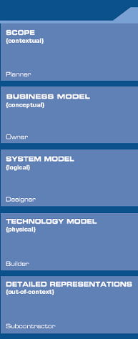

Implementation Architecture
System Architecture – Zachman Architecture Framework
List of business entities (i.e. Entity Classes.)
Description of relations between business entities (Entity =Business Entity, Relation=Business relations.)
Description of logical data model (Entity=Data Entity, Relation=Data Relations.)
Description of physical data model (Entity=Segment/Tables/etc., Relation=Pointer/Key/etc.)
Data definition (Entity=Field, Relation=Address.)
Source: The Zachman Framework for Enterprise Architecture

Slide 83

Implementation Architecture
System Architecture – Zachman Architecture Framework
List of business processes (Function=Class of Business Process.)
Description of business process model (Process =Business Process, I/O=Business Resources.)
Description of application functions (Process= Application Function, I/O = User Views.)
Description of system design (Process=Computer Function, I/O=Data Elements/Sets.)
Computer program (Process=Language Statement, I/O=Control Block.)
Source: The Zachman Framework for Enterprise Architecture

Slide 84

Implementation Architecture
System Architecture – Zachman Architecture Framework
List of locations (Node=Major Business Location.)
Description of business systems (Node=Business Location, Link=Internetworking Linkage.)
Description of system architecture (Node=InfoSys. Function, Link=Internetworking Characteristics.)
Description of technology architecture (Node=HWCI/ SWCI, Linkage=Internetworking Characteristics.)
Network architecture (Node=Address, Link=Protocols.)
Source: The Zachman Framework for Enterprise Architecture

Slide 85

Implementation Architecture
System Architecture – Zachman Architecture Framework
List of organizations (i.e. Stakeholders)
Description of work-flow model (People= Organization Unit, Work=Work Product.)
Description of human interface architecture (People= Role, Work=Deliverable.)
Description of presentation architecture (People= User, Work=Screen/User Interface.)
Security architecture (People=Identity, Work=Job Function.)
Source: The Zachman Framework for Enterprise Architecture

Slide 86

Implementation Architecture
System Architecture – Zachman Architecture Framework
List of Events (that is significant to the business.)
Description of master schedule (Time=Business Event, Cycle=Business Cycle.)
Description of process structure (Time=System Event, Cycle=Processing Cycle.)
Description of control structure (Time=Execute, Cycle=Component Cycle.)
Timing definition (Time=Interrupt, Cycle=Machine Cycle.)
Source: The Zachman Framework for Enterprise Architecture

Slide 87
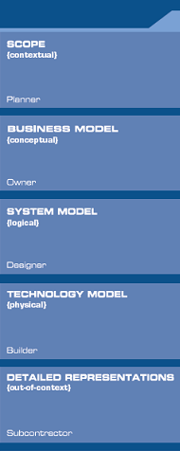

Implementation Architecture
System Architecture – Zachman Architecture Framework
List of business goals/strategy (Ends/Means=Major Business Goal/Success Factor.)
Description of business plan (Ends=Business Objectives, Means=Business Strategy.)
Description of business rule model (End=Structural Assertion, Means=Action Assertion.)
Description of rules design (End=Condition, Means= Action.)
Rule specification (End=Sub-condition, Means=Step.)
Source: The Zachman Framework for Enterprise Architecture

Slide 88
Implementation Architecture
System Architecture – DoD Architecture Framework
DoD Architecture Framework (DoDAF) is based on C4ISR Architecture Framework (C4ISR AF).
DoDAF 1.0 focuses on SYSTEMS
Reference: DoD Architecture Framework, Version 1.0, Volume I

Slide 89
Implementation Architecture
System Architecture – DoDAF 1.0
All View (AV)
AV-1 Overview and Summary Information
AV-2 Integrated Dictionary
Operational View (OV)
OV-1 High Level Operational Concept Graphic
OV-2 Operational Node Connectivity Description
OV-3 Operational Information Exchange Matrix
OV-4 Organizational Relationships Chart
OV-5 Operational Activity Model
OV-6a Operational Rules Model
OV-6b Operational State Transition Description
OV-6c Operational Event-Trace Description
OV-7 Logical Data Model
Technical Standards View (TV)
TV-1 Technical Standards Profile
TV-2 Technical Standards Forecast
Systems View (SV)
SV-1 System Interface Description
SV-2 System Communications Description
SV-3 System-System Matrix
SV-4 System Functional Description
SV-5 Operational Activity to Systems Functionality Traceability Matrix
SV-6 System Data Exchange Matrix
SV-7 System Performance Parameters Matrix
SV-8 System Evolution Description
SV-9 System Technology Forecast
SV-10a System Rules Model
SV-10b System State Transition Description
SV-10b System Event-Trace Description
SV-11 Physical Schema
Reference: DoD Architecture Framework, Version 1.0, Volume I
Notes:
Here are the products specified by DoD AF.
All View
AV-1 defines the context and scope and AV-2 is the integrated dictionary that contains the description of all terms used in the architecture.
Operational View (describes operational tasks and activities. A pure OV is materiel independent.)
OV-1 is general picture that describes the problem that the architecture is supposed to address.
OV-2 is the Operational Node Connectivity Description lists all the nodes that are referenced in the OV-5 along with their labeled information exchanges.
OV-3 is details all the information exchanges that have been labeled in the OV-2.
Technical Standards View (describes the technology standards, and implementation rules.)
TV-1 is essentially a list of technology standards. The ISSE shall focus on the FIPS and Common Criteria.
Systems View, and (describes the system, system components, system interconnections and system functions.)
SV-1, SV-2 describe the system interfaces and internetworking of systems.
SV-6 is the system data exchange matrix (a.k.a. information flow matrix)

Slide 90
Implementation Architecture
Enterprise System Architecture – DoDAF 2.0
Reference: DoD Architecture Framework, Version 2.0, Volume I

Slide 91
Implementation Architecture
Enterprise System Architecture – DoDAF 2.0
Project View (PV)
PV-1 Project Portfolio Relationships
PV-2 Project Timelines
PV-3 Project to Capability Mapping
Capability View (CV)
CV-1 Vision
CV-2 Capability Taxonomy
CV-3 Capability Phasing
CV-4 Capability Dependencies
CV-5 Capability to Organizational Development Mapping
CV-6 Capability to Operational Activities Mapping
CV-7 Capability to Services Mapping
Data & Information View (DIV)
DIV-1 Conceptual Data Model
DIV-2 Logical Data Model
DIV-3 Physical Data Model
Service View (SvcV)
SvcV-1 Services Context Description
SvcV-2 Services Resource Flow Description
SvcV-3a Systems-Services Matrix
SvcV-3b Services-Services Matrix
SvcV-4 Services Functionality Description
SvcV-5 Operational Activity to Services Traceability Matrix
SvcV-6 Services Resource Flow Matrix
SvcV-7 Services Measures Matrix
SvcV-8 Services Evolution Description
SvcV-9 Services Technology & Skills Forecast
SvcV-10a Services Rules Model
SvcV-10b Service State Transition Description
SvcV-10c Services Event-Trace Description
Reference: DoD Architecture Framework, Version 2.0, Volume I
Notes:
Here are the products specified by DoD AF.
All View
AV-1 defines the context and scope and AV-2 is the integrated dictionary that contains the description of all terms used in the architecture.
Operational View (describes operational tasks and activities. A pure OV is materiel independent.)
OV-1 is general picture that describes the problem that the architecture is supposed to address.
OV-2 is the Operational Node Connectivity Description lists all the nodes that are referenced in the OV-5 along with their labeled information exchanges.
OV-3 is details all the information exchanges that have been labeled in the OV-2.
Technical Standards View (describes the technology standards, and implementation rules.)
TV-1 is essentially a list of technology standards. The ISSE shall focus on the FIPS and Common Criteria.
Systems View, and (describes the system, system components, system interconnections and system functions.)
SV-1, SV-2 describe the system interfaces and internetworking of systems.
SV-6 is the system data exchange matrix (a.k.a. information flow matrix)

Slide 92
Implementation Architecture
Enterprise System Architecture – DoDAF 2.0
All View (AV)
AV-1 Overview and Summary Information
AV-2 Integrated Dictionary
Operational View (OV)
OV-1 High Level Operational Concept Graphic
OV-2 Operational Resource Flow Description
OV-3 Operational Resource Flow Matrix
OV-4 Organizational Relationships Chart
OV-5a Operational Activity Decomposition Tree
OV-5b Operational Activity Model
OV-6a Operational Rules Model
OV-6b State Transition Description
OV-6c Event-Trace Description
Standards View (StdV)
TV-1 Standards Profile
TV-2 Standards Forecast
Systems View (SV)
SV-1 Systems Interface Description
SV-2 Systems Resource Flow Description
SV-3 Systems-Systems Matrix
SV-4 Systems Functional Description
SV-5a Operational Activity to Systems Function Traceability Matrix
SV-5b Operational Activity to Systems Traceability Matrix
SV-6 Systems Resource Flow Matrix
SV-7 Systems Measures Matrix
SV-8 Systems Evolution Description
SV-9 Systems Technology & Skills Forecast
SV-10a Systems Rules Model
SV-10b System State Transition Description
SV-10b System Event-Trace Description
Reference: DoD Architecture Framework, Version 2.0, Volume I
Notes:
Here are the products specified by DoD AF.
All View
AV-1 defines the context and scope and AV-2 is the integrated dictionary that contains the description of all terms used in the architecture.
Operational View (describes operational tasks and activities. A pure OV is materiel independent.)
OV-1 is general picture that describes the problem that the architecture is supposed to address.
OV-2 is the Operational Node Connectivity Description lists all the nodes that are referenced in the OV-5 along with their labeled information exchanges.
OV-3 is details all the information exchanges that have been labeled in the OV-2.
Technical Standards View (describes the technology standards, and implementation rules.)
TV-1 is essentially a list of technology standards. The ISSE shall focus on the FIPS and Common Criteria.
Systems View, and (describes the system, system components, system interconnections and system functions.)
SV-1, SV-2 describe the system interfaces and internetworking of systems.
SV-6 is the system data exchange matrix (a.k.a. information flow matrix)

Slide 93
Implementation Architecture
Determining the Architecture Model
Architecture is a high-level description of system.
  Intended use
  Scope
  Characteristics to be captured
  Organization of data for designing a system
Reference: Enterprise Security Architecture – A Business-Driven Approach, John Sherwood, 2005

Slide 94
Implementation Architecture
Security Architecture – FEA Framework
Federal Enterprise Architecture Framework (FEAF) focuses on BUSINESS
Reference: FEA Consolidated Reference Model, Version 2.3, October 2007

Slide 95
Implementation Architecture
Security Architecture – FEA Framework – Performance Reference Model (PRM)
Measurement Areas: Mission and Business Results, Customer Results, Processes and Activities, Human Capital, Technology, and Other Fixed Assets.
Measurement Categories: Collections within each measurement area describing the attribute or characteristic to be measured.
Measurement Groupings: Specific types of measurement indicators.
Measurement Indicators: The specific measures, e.g. number and/or % of customers satisfied, tailored for a specific BRM LoB or Sub-function, agency, program, or IT initiative.
Reference: FEA Consolidated Reference Model, Version 2.3, October 2007

Slide 96
Implementation Architecture
Security Architecture – FEA Framework –
Business Reference Model (BRM)
Business Area: Services for Citizens, Mode of Delivery, Support Delivery of Services, and Management of Government Resources.
Line of Business (LoB): Each business area (i.e. agency) has a set of LoBs (/ functional organizations) (e.g. IT, Supply Chain, HR, Financial Management, etc.)
Sub-function: Each LoB has sub-functional organization(s) (e.g. Lifecycle/Change Management, System Development, System Maintenance, Information Systems Security, Information Management, etc.)
Reference: FEA Consolidated Reference Model, Version 2.3, October 2007

Slide 97
Implementation Architecture
Security Architecture – FEA Framework –
Service Component Reference Model (SRM)
Service Domain: Customer Services, Process Automation, Business Management Services, Digital Asset Services, Business Analytical Services, Back Office Services, Support Services
Service Type: Each service domain has a set of specified service types (e.g. Management of Process, Organizational Management, Investment Management, Supply Chain Management, etc.)
Component: Each service type has a set of specified service components (e.g. Procurement.
Reference: FEA Consolidated Reference Model, Version 2.3, October 2007

Slide 98
Implementation Architecture
Security Architecture – FEA Framework –
Technical Reference Model (TRM)
Service Areas: Service Access and Delivery, Service Platform and Infrastructure, Component Framework, Service Interface and Integration.
Service Category: Each service area has several identified service categories (e.g. Access Channels, Delivery Channels, Support Platforms, Delivery Servers, HW/SW, Security, Data Interchange, Management, etc.)
Service Standard: Technologies that are identified as the Agency standards (e.g. FIPS 140-2, IEEE 802.11n, HTTP, TLS v1.0, etc.)
Reference: FEA Consolidated Reference Model, Version 2.3, October 2007

Slide 99
Implementation Architecture
Security Architecture – FEA Framework –
Data Reference Model (DRM)
Data Description: Provides a means to uniformly describe data, thereby supporting its discovery and sharing
Data Context: Facilitates discovery of data through an approach to the categorization of data according to taxonomies.
Data Sharing: Supports the access and exchange of data where access consists of ad-hoc requests, and exchange consists of fixed, reoccurring transactions between parties. Enabled by capabilities provided by both the Data Context and Data Description standardization areas.
Reference: FEA Consolidated Reference Model, Version 2.3, October 2007

Slide 100
Implementation Architecture
Allocate Security Services – Defense-in-Depth …(1/2)
Successful Organization Functions
Information Assurance
“Defense-In-Depth” Strategy
People
People
Executing Operations Supported by Technology
Operations
Technology
Information Assurance Technical Framework (IATF)
Overlapping Approaches & Layers of Protection
Defending the Network & Infrastructure
Defending the Enclave Boundary
Defending the Computing Environment
Supporting
the Infrastructure
Reference: IATF Release 3.1

Slide 101
Implementation Architecture
Allocate Security Services – Defense-in-Depth …(2/2)
A good Security Architecture should be able to explain security controls at:
  Operations Layer
  Contextual-level
  Conceptual-level
  Logical-level
  Physical-level
  Component-level

Slide 102
Information Security Concepts
System Requirements
Functional Requirements
  Example:
  The information system shall support the FISMA reporting, mandated by OMB, in the following format :
  • The number of information systems by FIPS 199 security categories.
  • The number of systems for which security controls have been tested and evaluated in the past year.
Performance Requirements
  Example:
  What extent the agency-wide security configuration policy (i.e., NIST Checklist Program [a.k.a. National Checklist Program]) has been implemented.

Slide 103
Information Security Concepts
Information Security Requirements
Assurance Requirements
  Example:
  SC-3: Security Function Isolation. The information system isolates security functions from non-security functions.
Functional Requirements
  Example:
  VLAN technology shall be created to partition the network into multiple mission-specific security domains.
  The integrity of the internetworking architecture shall be preserved by the access control list (ACL).

Slide 104
Implementation Architecture
Security Controls
Security controls are the management, operational, and technical safeguards/countermeasures prescribed for information systems or organizations that are designed to:
  protect the confidentiality, integrity, and availability of information that is processed, stored, and transmitted by those systems/organizations; and
  Satisfy a set of defined security requirement.
Key questions:
  What security controls are needed to satisfy the security requirements and to adequately mitigate risk incurred by using information and informaiton systems in the execution of organizational missions and business functions?
  Have the security controls been implemented, or is there an implementation plan in place?
  What is the desired or required level of assurance that the selected security controls, as implemented are effective in their application?
Reference: NIST SP 800-53, Rev. 4, Security and Privacy Controls for Federal Information Systems and Organizations.

Slide 105
Information Security Concepts
Categories of Security Controls …(1/4)
Management (Administrative) Controls.
  Policies, Standards, Processes, Procedures, & Guidelines
    Administrative Entities: Executive-Level, Mid.-Level Management
Operational (and Physical) Controls.
  Operational Security (Execution of Policies, Standards & Process, Education & Awareness)
    Service Providers: IA, Program Security, Personnel Security, Document Controls (or CM), HR, Finance, etc
  Physical Security (Facility or Infrastructure Protection)
    Locks, Doors, Walls, Fence, Curtain, etc.
    Service Providers: FSO, Guards, Dogs
Technical (Logical) Controls.
  Access Controls , Identification & Authorization, Confidentiality, Integrity, Availability, Non-Repudiation.
    Service Providers: Enterprise Architect, Security Engineer, CERT, NOSC, Helpdesk.

Slide 106
Information Security Concepts
Categories of Security Controls …(2/4)
CLASS | FAMILY | IDENTIFIER
Management | Risk Assessment | RA
 | Planning | PL
 | System and Services Acquisition | SA
 | Certification, Accreditation, and Security Assessment | CA
 | Program Management | PM
Operational | Personnel Security | PS
 | Physical and Environmental Protection | PE
 | Contingency Planning | CP
 | Configuration Management | CM
 | Maintenance | MA
 | System and Information Integrity | SI
 | Media Protection | MP
 | Incident Response | IR
 | Awareness and Training | AT
Technical | Identification and Authentication | IA
 | Access Control | AC
 | Audit and Accountability | AU
 | System and Communications Protection | SC
Reference: NIST SP800-53, Rev 3, Recommended Security Controls for Federal Information Systems

Slide 107
Information Security Concepts
Categories of Security Controls …(3/4)
ISO/IEC 27001:2005, Information Technology – Security Techniques – Security Management System – Requirements
CONTROL CATEGORY | SUB-CATEGORY OF CONTROLS
Security Policy | Information security policy
Organization of Information Security | Internal organization; External parties
Asset Management | Responsibility for assets; Information classification
Human Resource Security | Prior to employment; During employment; Termination or change of employment
Physical and Environmental Security | Secure areas; Equipment security
Communications and Operations Management | Operational procedures and responsibilities; Third party service delivery management; System planning and acceptance; Protection against malicious and mobile code; Back-up; Network security management; Media handling; Exchange of information; Electronic commerce services; Monitoring
Access Control | Business requirement for access control; User access management; User responsibilities; Network access control; Operating system access control; Application and information access control; Mobile computing and teleworking
Information Systems Acquisition, Development, and Maintenance | Security requirements of information systems; Correct processing in applications; Cryptographic controls; Security of system files; Security in development and support processes; Technical vulnerability management
Information Security Incident Management | Reporting information security events and weaknesses; Management of information security incidents and improvements
Business Continuity Management | Information security aspects of business continuity management
Compliance | Compliance with legal requirements; Compliance with security policies and standards, and technical compliance; Information system audit considerations

Slide 108
Information Security Concepts
Implementable & Testable Security Requirements …(4/4)
Assurance requirements are generic; they define information protection needs. For example:
  From SP 800-53: SC-6: Resource Priority. The information system limits the use of resources by priority.
  From ISO 27001: A.10.3.1: Capacity Management. The use of resources shall be monitored, tuned, and projections made of future capacity requirements to ensure the required system.
Functional requirements defines “what & how” the system shall perform in meeting information protection needs.
  Generated through system
  engineering process
Reference: Systems Engineering Principles and Practice, A. Kossiakoff, W. Sweet, S. Seymour, S. Biemer, 2011.

Slide 109
Questions:
What architecture framework is best for defining the relationship between business investment and system components?
What architecture framework is designed for defining the IT enterprise systems?
What architecture framework is designed specifically for U.S. Department of Defense?

Slide 110
Answers:
What architecture framework is best for defining the relationship between business investment and system components?
  Federal Enterprise Architecture (FEA) Framework
What architecture framework is designed for defining the IT enterprise systems?
  Zachman Enterprise Architecture Framework
What architecture framework is designed specifically for U.S. Department of Defense?
  DoD Architecture Framework

Slide 111
Validation Time… ☺
Class Exercise
Review Answers

Slide 112
Exercise #1: Security Models
Discuss & provide example implementations for the Bell-LaPadula security model?
How is a high assurance guard (HAG) related to the Bell-LaPadula security model?
Discuss & provide example implementations for the Clark-Wilson security model?
How is an internet proxy server related to the Clark-Wilson security model?

Slide 113
Exercise #2: Security Requirements & System Architecture
Discuss how is NIST SP 800-53 or ISO 27001 specified security controls are…
Related to system functional requirements?
Related to system architecture & detailed design?
Discuss how are functional requirements relate to STIGs, CIS Benchmarks, or FDCC security settings?

